Slide 1
Learning Objective : To understand the law and procedure of counting of votes Please note this PPT is made as training aid and shall in no manner be taken as substitute of Statutory provisions and ECI directions . In case of doubts, please refer to them.

Slide 2
Learning Objective : To understand law and procedures of the counting of votes.
1
To understand legal provisions and ECI guidelines on counting of votes and related issues
2
To ensure infrastructures and security arrangements at counting centers
3
To understand how to appointment counting staff and counting agents
4
How to do counting of Postal ballots ?
5
How to do counting of votes recorded in EVMs
6
How to seal EVMs and election materials after completion of counting
7 How and when to Declare result and take subsequent actions
8 Miscellaneous issues

Slide 3
Sub Learning Objective 1: Major legal provisions related to counting and election return
R.P. ACT 1951
Sec 64: Counting of Votes
Sec 64A: Destruction, loss etc. of ballot papers at the time of counting
Counting under supervision and direction of the RO.
RO shall immediately report the matter to ECI who may direct the counting to be stopped.
Contesting candidate /election agent/ /counting agents have a right to be present.
Or if satisfied the result of election will not get materially affected, may allow counting to be completed.
ECI may further declare poll to be void, order re-poll for that polling station.

Slide 4
Sub Learning Objective 1: Major legal provisions related to counting and election return
RP ACT 1951 ( Contd)
Sec 65: Equality of Votes
Results to be decided by draw of lot by RO.
Sec 66: Declaration of Results
In the absence of any direction to the contrary from ECI, RO to declare the result.
Sec 67: Report of the Result
RO to report result to ECI& to Appropriate Authority (i.e. Secretary State Legislature/ Parliament, who shall get it published in official Gazette immediately.

Slide 5
Sub Learning Objective 1: Major legal provisions related to counting and election return
Sec 128: Maintenance of secrecy of voting
Applicable to officer/clerk/agent/person performing duty in connection to Election ( during poll or counting).
RO/ARO should take an oath to maintain secrecy of voting & read it out aloud before the commencement of counting of votes.
Sec 129: Officers, etc. at elections not to act for candidates or to influence voting
Applicable to DEO/RO/AROs/Polling staff.
Imprisonment up to 6 months /fine/both .
Sec 136: Other offences and penalties thereof [Sub sections to (1)-(4)]
Guilty of electoral offence: tampering with EVM/ballot box or ballot paper /nomination paper etc fraudulently
Imprisonment up to 6 months or 2 years /fine /both
Violation punishable with 3 months imprisionment or fine or with both.

Slide 6
Sub Learning Objective 1: Major legal provisions related to counting and election return
CONDUCT OF ELECTION RULES, 1961
Rule 66A: In relation to counting of votes where EVMs used, the provisions of Rules 50-54 have been made applicable. And in lieu of Rule 55, 56 and 57, Rules 55C, 56C and 57C have been made applicable.

Slide 7
Sub Learning Objective 1: Major legal provisions related to counting and election return
Conduct of Elections Rules, 1961
Rule 51: Time and place for counting
To be fixed by RO at least one week before date of counting
Rule 52 : Appointment of Counting Agents
Subject to ECI directions, a candidate may appoint counting agents which shall not exceed 16 for each place of counting
Notice to given to in writing to each candidate/his election agent
Appointment to be made in FORM 18, in duplicate. One copy for RO for record and other copy to agent for production before RO, not later than one hour before the time fixed for counting
Revocation in FORM 19
No entry in counting hall unless second copy of FORM 18 is given to RO after signing the declaration

Slide 8
Sub Learning Objective 1: Major legal provisions related to counting and election return
Rule 53: Admission to the place of counting
No body else except RO/ARO, counting staff, candidates, their election agents and counting agents public servants on duty, persons authorized by ECI
Rule 54: Secrecy of voting
RO to read out provision of section-128 aloud before commencement of counting.
Whosoever misconducts himself or fail to obey lawful direction of RO shall be removed from counting hall.

Slide 9
Sub Learning Objective 1: Major legal provisions related to counting and election return
Rule 55C: Scrutiny and inspection of EVMs before counting
Counting staff and counting agents to inspect and ensure that the CU is not tempered and all seals are intact. In case not, report matter to ECI
Rule 56C: Actual counting
1. Press the result button and see the display of votes count.
2. Note down the same in part-II of form 17C. Counting supervisor to sign on it along with willing candidate counting agent
3. Corresponding entries to be made in form-20
Rule 57C: EVMs after counting.
After, result is recorded in part-II of form 17C, the CU to be sealed with the seals of the RO and candidates/ counting agents.

Slide 10
Sub Learning Objective 1: Major legal provisions related to counting and election return
Rules 60 provides for continuous counting
Rule 61 provides for re-commencement of counting after fresh poll
Rule 63 provides for recount of votes
Rule 64 provides for declaration of result of election
Rule 66 provides for grant of certificate of election to returned candidate
Rule 65 provides for counting at 2 or more places for one constituency

Slide 11
Sub Learning Objective 2: Infrastructure and security arrangements at counting centres
Selection of counting centre-
Counting place should be decided in consultation with police authorities at least one week before the date of poll. (If poll being taken in phases then the first date)
ECI fixes a common date and time of counting which shall have be intimated to contesting candidates well in advance.
Preferably place of counting of a constituency should be in district HQ. No objection if it is outside the area for cogent reasons.
Each constituency should be counted in a separate hall. (No exception. In case adequate halls are not available, then counting to be done in sequence i.e. first, one AC counting will be completed and thereafter the next one).
In simultaneous poll to Lok Sabha and LA, both to be counted in the same hall. Half of the tables in one side for LA and the rest in other side for LA.

Slide 12
Sub Learning Objective 2: To ensure infrastructure and security arrangements at counting centres
Selection of counting centre( Contd)
RO need to forward the proposal of counting centers in consultation with the observer in in Annexure 42-C of HB of RO to ECI through CEO for approval at the earliest after last date for withdrawal of nominations.
After ECI has approved the same a mandatory notice to candidates has to be given in Annexure 43-A or 43-B of Hand Book of RO.
If, for any unavoidable reasons, the RO is unable to conduct counting on notified date /time, he should postpone counting to another date and time after obtaining approval of ECI.
The counting should not be done in a temporary structure.

Slide 13
Sub Learning Objective 2: Infrastructure and security arrangements at counting centers
Selection of counting centre ( Contd)
Counting of votes for entire AC to be preferably done at one place
If more than two halls or places are required, ECI’s written prior approval is required
In case 2 halls are approved, allot in advance the PS to be counted in each hall. Intimate candidates accordingly
For Each AC or assembly segment there should be a strong room and a spacious counting hall with separate entry and exit.
Each counting centre to have distinct number and each hall to be distinctly numbered

Slide 14
Sub Learning Objective 2: Infrastructure and security arrangements at counting centres
Should be spacious enough to accommodate infrastructure and officials and agents
Should have adequate lighting with proper standby arrangements (generator, etc.)
Adequate fire extinguishing equipment
Should be a permanent structure. If unavoidably temporary, take ECI approval
Infrastructure at Counting Centre

Slide 15
Sub Learning Objective 2: To ensure infrastructure and security arrangements at counting centres
Infrastructure at Counting centre/hall ( Contd)
No. of tables in counting hall depends upon
No. of polling stations to be counted. Selection of counting centre ( Contd
Space available
No. of counting agents
No. of counting staff including micro-observers
Security concerns
In one hall, counting tables should not exceed 14 (during last Lok Sabha elections 2009, even 25 tables were allowed, with ECI’s prior approval, provided hall was big enough). In addition to this one table each for RO and observer. The candidates or their agents will be allowed to sit on ROs Table to watch the counting process. A table with computer on which computation and compilation of data from each table after each round shall be done, should be alongside of ROs table. If the tabulation is done at the table other than ROs table then one additional counting agent besides micro observer will be allowed to sit in on the tabulation table.
Adequate barricades using transparent material for each counting table to prevent agents/candidates/representatives from handling polled EVMs, but agents should be able to view entire process

Slide 16
Sub Learning Objective 2: To ensure infrastructure and security arrangements at counting centres

Slide 17
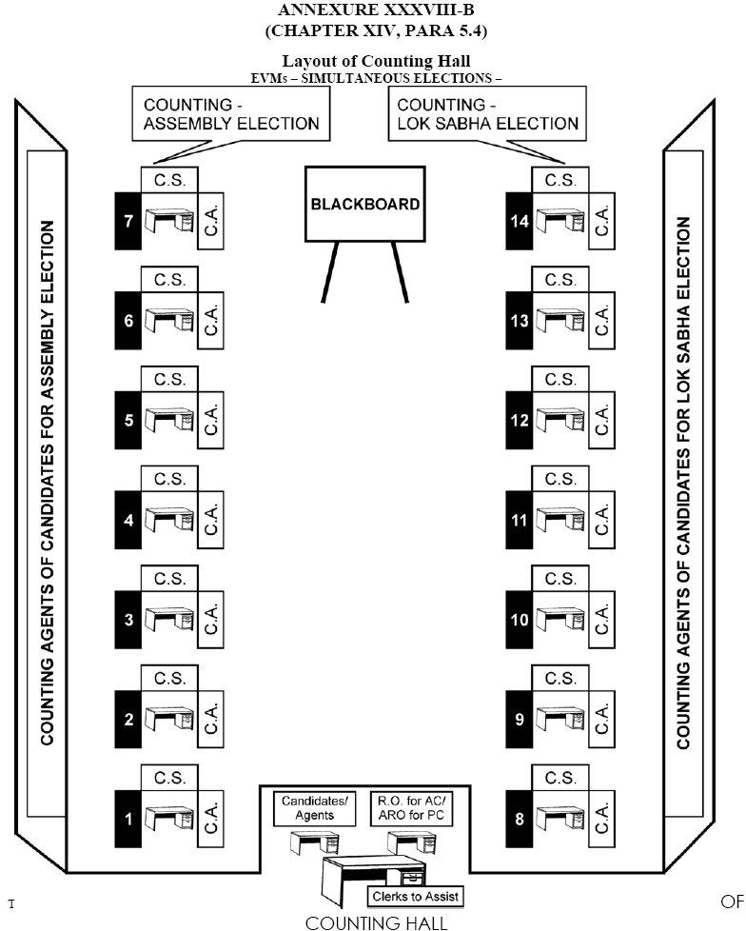
Sub Learning Objective 2: To ensure infrastructure and security arrangements at counting centres

Slide 18
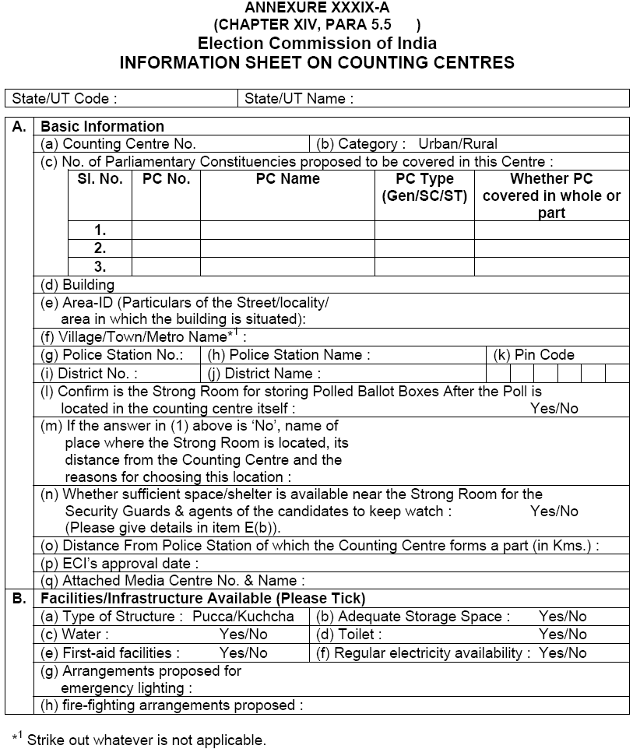
Sub Learning Objective 2: To ensure infrastructure and security arrangements at counting centres

Slide 19
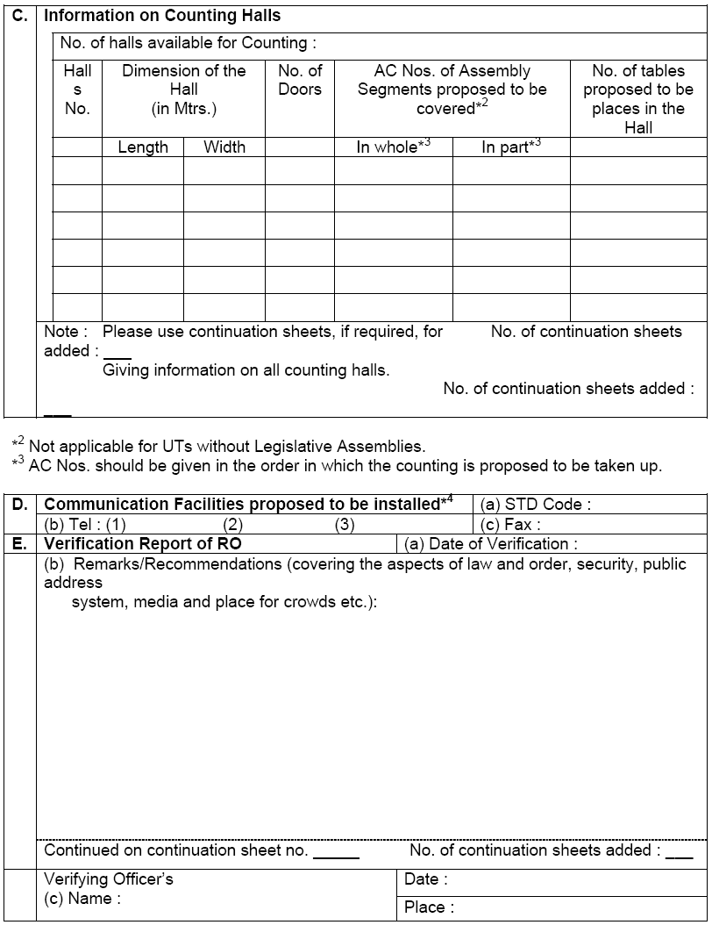
Sub Learning Objective 2: To ensure infrastructure and security arrangements at counting centres
19

Slide 20
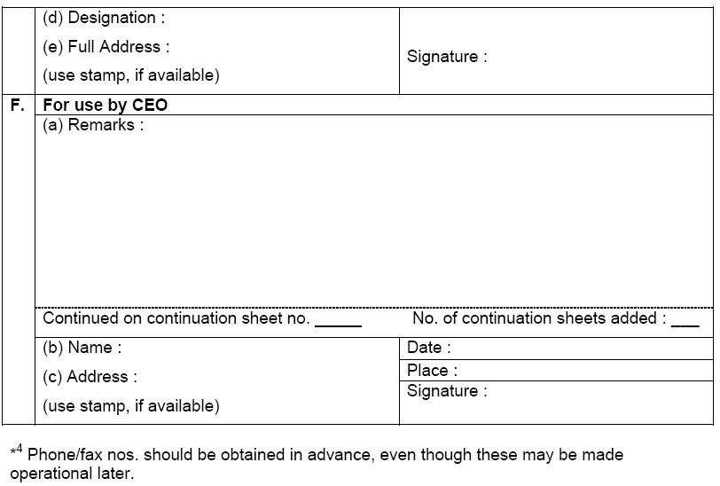
Sub Learning Objective 2: To ensure infrastructure and security arrangements at counting centres
20

Slide 21
Sub Learning Objective 2: To ensure infrastructure and security arrangements at counting centres
Infrastructures at counting centre ( Contd)
Provide at every counting table, a blue ballpoint pen, paper knife for breaking open seals and two sheets of paper.
Make arrangement of loud speaker and a black board for dissemination information regarding trends in counting and results to public and media.
Adequate arrangements for official videography. No static camera to be allowed inside counting hall.
Arrangements at counting centre- Observer should be provided:
Separate Room/Cubicle with tables and chairs.
Telephone with STD and fax attached exclusively for use of Observer to communicate in strict confidentiality.
Number for this telephone to be obtained from phone company 15 days before counting date.

Slide 22
Sub Learning Objective 2: To ensure infrastructure and security arrangements at counting centres
Infrastructures at counting centre ( Contd) )
Arrangements at counting centre for yourself:
A hotline with CEO
One more STD telephone to keep in touch with CEO & ECI
Fax and photocopy machines at each counting centre
Computer centre with power backup with facility for online transmission through GENSYS
NOTE only ECI observers and RO/ARO allowed to use mobile phone inside the counting hall.
Media Centre with a officer from Public Relation Deptt -outside counting halls with adequate facilities:
Telephone
Fax
Data communication
Suitable arrangements to keep mobile phones of media personnel, since they can’t visit counting hall with mobile.
There may be a common media centre for all constituencies at a counting centre.
Public Communication Room-
From here candidates and their agents can use their mobile. Suitable arrangements to keep mobile phones .

Slide 23
Sub Learning Objective 2: To ensure infrastructure and security arrangements at counting centres
SECURITY ARRANGEMENTS
At Storage place of polled EVMs- TWO tier security arrangements round the clock at the strong rooms having polled EVMs. Innermost perimeter by CPF and outer perimeter by State Armed Police(SAP).The candidates representatives to be allowed to stay outside the inner perimeter at a location which enables them to view entry points of the strong room. If no direct view, then CCTV arrangements to be made. So that they can see the gates of strong rooms. In CCTV case, they shall be taken periodically in batches to strong room to see and verify themselves strong room. Round the clock control room in a adjacent room with a Gazetted officer. A log book shall be maintained by the CPF to record date, time, duration and names of any one, Including DEO/SP/RO/Observer/Candidates or their agents etc, crossing the 2nd ring.

Slide 24
Sub Learning Objective 2: To ensure infrastructure and security arrangements at counting centres
SECURITY ARRANGEMENTS
(Continued from previous slide)
The CPF contingent shall be given a camera to record such visits. Last but not least, all entry points of strong room should be under constant videography using web cam and laptops. Person deputed to take back up from lap top should be issued a photo- I card and his names etc be intimated to CPF posted there. DEO shall visit storage campus (up to inner perimeter only) everyday morning and evening, if storage campus is in district HQ. If outside then by RO but DEO to visit a at least once in a 3-4 days.
Round the clock uninterrupted power supply, adequate fire extinguishers etc to be arranged for.
No vehicle, official or private shall be allowed inside the secured campus.

Slide 25
Sub Learning Objective 2: To ensure infrastructure and security arrangements at counting centres
SECURITY ARRANGEMENTS
At Counting centers-
First of all, smooth flow of EVMs from strong room to counting hall and vice versa , has to be ensured.
100 meter perimeter around a counting premise to be demarcated as ‘Pedestrian Zone ‘. Must be duly barricaded with a entry gate to enter into counting premise. and no vehicle to be allowed to cross this.
Three tier cordoning system. The 1st and outer cordon to start from pedestrian zone. Must have adequate local police forces with a senior magistrate to check identity of the entrants. Persons with photo I cards issued by ECI or DEO only to be allowed to cross.
2nd cordon will be at the gate of counting premise/campus and will be manned by SAP. Checking of identity and frisking ( only by state police personnel) to be done.
3rd cordon at the door of counting hall. CPF to be present. Frisking to ensure that no one enters with mobile and other prohibited items.

Slide 26
Sub Learning Objective 2: To ensure infrastructure and security arrangements at counting centres
PERSONS ALLOWED INTO COUNTING HALL
(Para 15.13 of HB of RO)
Counting supervisors and assistants
Persons authorized by ECI
Public servants on duty in connection with election
Candidates, their election agents and counting agents
Every body inside the counting hall shall have to display his I-card on his/her person.
24

Slide 27
PERSONS NOT ALLOWED INTO COUNTING HALL
Police personnel, whether in uniform or plain clothed, NOT allowed. Must remain outside and can enter only when called by RO to come to control
Ministers, State Ministers, Dy. Ministers of Union & state unless they are candidates
The above cannot be appointed as election or counting or polling agent of candidate as they require security
Counting agents cannot enter unless s/he has submitted 2nd copy of appointment letter after completing and signing declaration

Slide 28
Sub Learning Objective 2: To ensure infrastructure and security arrangements at counting centers
PRIORITY IN SEATING IN COUNTING HALL (subject to seating capacity) (Para 15.14.1 of HB of RO)
1. Agents of candidates of recognized national parties
2. Agents of candidates of recognized state parties
3. Agents of candidates of recognized state parties of other states permitted to use reserve symbol
4. Agents of candidates of registered unrecognized parties
5. Agents of Independents Candidates

Slide 29
Sub Learning Objective 3: To ensure infrastructure and security arrangements at counting centres
DISCIPLINE & DECORUM IN COUNTING HALL
Agents to keep seated at allotted table. No one is allowed to carry mobile phones except RO/ Observer.
Agents shouldn’t be allowed to move about hall. However, Candidates/ Election Agents can move around hall.
Only one person – either candidate or agent to be present at a table on behalf of contesting candidate.
If RO doubts any person he can have him/her searched, even if they possess valid authorization letter.
Police officials posted at doors of counting hall.
No one can enter or leave hall without RO’s permission.
RO can send anyone out of hall if they disobey RO’s orders.

Slide 30
Sub Learning Objective 2: counting staff & counting agents
Counting staff is appointed by the RO concerned.
Format of Appointment letter prescribed in Annexure 44 of HB of RO.
Requirement to be assessed on basis of no. of counting halls and no. of counting tables plus reserve. For each table:
One Counting Supervisor (preferably a Gazetted officer of Central/ State govt. or officer of equivalent status of PSUs.
One Counting Assistant
One micro observer ( a Central Govt. official)
One Group D employees
Also --
Reserve staff
Additional Counting Assistant for Observer to do parallel counting

Slide 31
Sub Learning Objective 2: To ensure arrangements of counting staff & counting agents
Randomization shall be done from the database of election officials using randomization software
120% of required number for the district one week before the date of counting. Presence of Observer not necessary
AC wise randomization before 24 hours of counting in the presence of the observer.
Issue the appointment letters to counting staff with a direction to report to respective counting centre on counting day
The allotment of tables to each counting supervisor/ counting assistants/ micro-observer shall be done in the presence of the observer at 5 AM of the counting day. This randomization can be done manually also.
Adequate trainings with doubt clearing sessions must .

Slide 32
Sub Learning Objective 2: To ensure arrangements of counting staff & counting agents
Ro to inform each contesting candidate that he is entitled to as many counting agents as there are counting tables plus one for RO table and one for tabulation table.
Appointment of counting agents in Form 18. revocation in Form 19.
Any application on plain paper to be rejected. Form 18 to be submitted in duplicate. The RO will keep one copy and return the 2nd copy. On counting day, the agents will sign the declaration part of the Form 18 and give it to the RO.
Finalize list of counting agents appointed through Form 18 by 1700 hours 3 days prior to date of counting
Issue photo identity cards to such counting agents under your seal and sign- No entry into counting hall with I-card
Counting agent should sign on badge immediately.

Slide 33
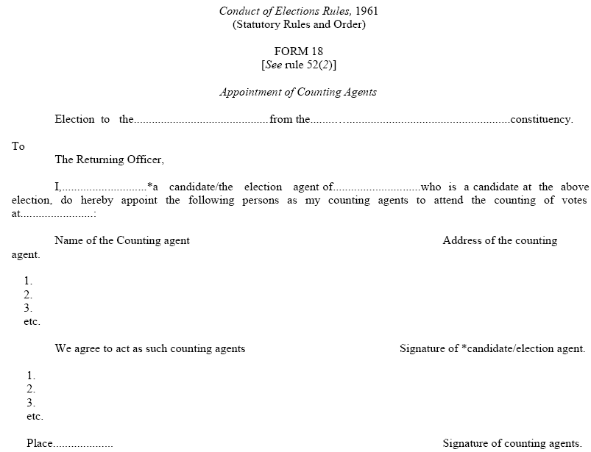
Form 18: Appointment of Counting Agents

Slide 34
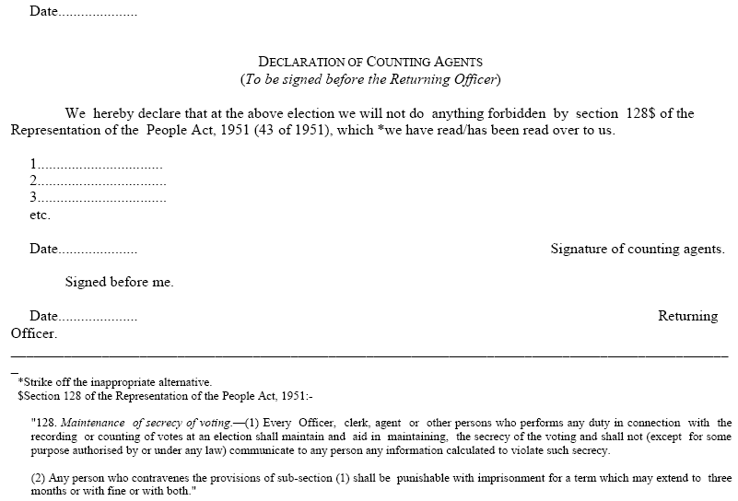
Form 18: Appointment of Counting Agents
32

Slide 35
Sub Learning Objective 4: To carry out the counting of votes received through Postal ballots as per ECI instructions
NOW LET US MOVE TO UNDERSATND ACTUAL COUNTING PROCESS.
33

Slide 36
Sub Learning Objective 4: counting of votes received through Postal ballots
Under Rule 54A, postal ballot papers are to be counted first so in all cases, 1st round shall be for PBs only. (However, it has to be completed before start of penultimate round of EVM counting).
Counting of votes in EVM can be commenced 30 minutes after start of Postal Ballot counting, even if the latter is not completed. Not necessary to wait further.
Counting of PBs to be done at RO’s table only.
One ARO may be specifically designated for supporting the RO for postal ballots.
All PBs received before the hours set for commencement of counting shall be brought before RO and counted.
Covers in Form 13C containing PB received after fixed hour shall not be opened. They should be rejected and kept in sealed separate packets with particulars noted on it.
Covers in Form 13C received in time to be opened one by one.
33

Slide 37
Sub Learning Objective 4: counting of votes received through Postal ballots
As each cover is opned, take out declaration in Form 13A and cover in Form 13B. If no declaration is found in the cover i.e 13B, then reject.
Scrutinize Declaration
Reject if not duly signed/attested by competent authority
Also reject if substantially defective or Serial Number in 13 A and in cover i.e.13 B does not match. The cover containing PB shall not be opened.
Each rejected cover to be endorsed suitably; Such declaration 13 A & cover (Form 13B) be put back in cover i.e. Form 13C. Then….
All OK declarations to be kept together in a separate envelop and sealed so that secrecy of ballot is not violated
This must be done before cover in Form 13B containing ballot paper is opened
Now open 13 B and scrutinize Postal Ballot Paper and take decisions.
all such covers to be kept separately in an envelop and sealed with particulars noted on top for easy identification

Slide 38
Sub Learning Objective 4: counting of votes received through Postal ballots
Count valid votes and credit each candidate with votes given to him
Calculate total number of votes received by each candidate
This should be carefully entered in Result Sheet in Form 20 at appropriate column.
Announce the result aloud of the 1st round i.e. PB round for information of candidates
All valid and rejected PBs to be bundled, packed, sealed with your seal, candidates’ seal if they wish and then ECI Secret seal
Particulars (name of constituency, date of counting, brief description of contents) on sealed packet

Slide 39
Sub Learning Objective 4: counting of votes received through Postal ballots
Postal Ballot Paper rejected if:
No vote is recorded
Votes given for more than one candidate
It is spurious ballot paper
It is damaged/mutilated that its doubtful if PB is genuine
Not returned in cover sent along with it to elector by you
Mark placed in such a way that it is doubtful for which candidate vote has been given
It bears mark apart from vote or writing by which voter can be identified
No particular mark as per law to be made by voter to record vote on PB
Any mark is valid if it is clear beyond reasonable doubt in favor of which candidate vote has been given
It should not be rejected if mark has been made more than once to clarify choice
Sealing of packets should be done using RO as well as Commission’s secret seal. Candidates also allowed to use their seals.

Slide 40
Sub Learning Objective 5: To carry out counting of votes recorded in EVMs as per ECI instructions
EVMs to be distributed sequentially, i.e. PS no. 1 to Table 1 and so on. Nodal officer to ensure.
Keep account of such distribution with you
Only CU required for Counting . BU to be brought into hall only if inspection required.
Along with CU, sealed cover containing Form 17C (Account of Votes) to be brought to counting table.
Remove the seals from carrying case, take out CU. Place on table for inspection of seals by Candidates/ agents .
If seal is properly intact and there is no tampering, votes will be counted.
Proceed further
…..Decide if clerical errors or actually tampered with. If tampered with, keep aside and inform ECI immediately
When taken out of carrying case, check:
That it is the same CU supplied to the PS
Seal on Cand set Section is intact.
Outer Strip Seal in Result Section.
CHECK that green paper seal is intact and its S. No. tally with paper seal account prepared by PrO in Form 17C : Part I: Item 9. ……
Check SN of Pink paper seal affixed on CU .
Special Tag‘ in Result Section.
37

Slide 41
Sub Learning Objective 5: To carry out counting of votes recorded in EVMs as per ECI instructions
Switch ‘On’ the CU
Press the ‘Total’ button and check whether total votes shown on display panel are matching with part-I of Form 17C
If everything OK, then pierce paper seal over Result I button provided in inner cover of result section
Press the ‘Result I’ button.
Total no. of votes for each candidate will be displayed for that PS. Lift the unit and show it to all agents so that they can note down votes polled by candidates.
Counting Assistant to note result in Part –II – Result of Counting of Form 17C.
If required, press again to show result to candidates/agents so that they are satisfied.
After result noted in Form 17 C-part II, close cover of result section and Switch “OFF” CU.
If not, check if it is clerical mistake. In case, the RO can not resolve the matter and there is dispute, keep the EVM aside and report the matter to ECI for further direction

Slide 42
Sub Learning Objective 5: To carry out counting of votes recorded in EVMs as per ECI instructions
Counting Supervisor to tally Result noted in part II of Form 17C and that noted down in Item 5: Part I: Form 17C
After completing form, counting supervisor to sign it
Request candidates’/agents’ present at table to also sign .
Counting Supervisor should then hand over duly completed 17C to RO.
RO to countersign in part-II of 17C after satisfying himself.
Thereafter 17C should be sent to the Officer compiling final result in Form 20.
On basis of individual Form 17C, RO to get prepared a round wise statement in the prescribed format. RO and Observer to sign it after necessary checks.
Announce the votes polled against each candidate round-wise after having it written on a black board so everyone can see. A copy of round wise result to be kept in Obs .folder and one copy to each candidate.
Observer to do parallel counting of 2 PS, randomly selected, with the help of Addl. Counting staff to get satisfied that votes tally with Form 17C

Slide 43
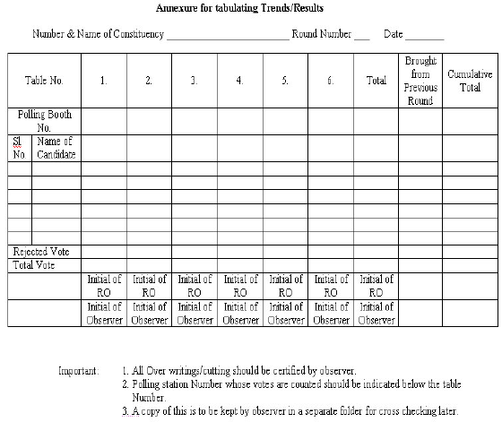
Sub Learning Objective 5: To carry out counting of votes recorded in EVMs as per ECI instructions
Round wise statement proforma

Slide 44
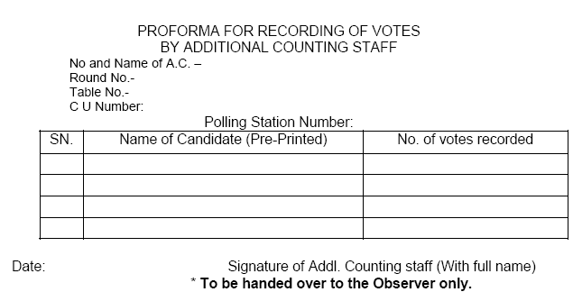
Sub Learning Objective 5: To carry out counting of votes recorded in EVMs as per ECI instructions
Proforma for recording of Votes by Additional Counting Staff

Slide 45
Sub Learning Objective 5: To carry out counting of votes recorded in EVMs as per ECI instructions
Officer compiling result in Result Sheet in Form 20 will do so strictly as per entries in Part II of Form 17 C.
He will note down no. of tendered votes polled, if any, in Form 20. Take note that these are not be counted.
For AC, Final Result Sheet You need to prepare only Part I of Form 20 where you mention no. of postal votes received by each candidate. In LS election Part II also to be filled up.
After all details have entered in Form 20, strike the grand total credited to each candidate, grand total of postal and votes polled at PS
Carefully check entire Form 20 if all entries have been made for every PS and it is not incomplete
Grand total should be struck accurately as discrepancy in the form will affect the result of election and declaration of result. This will invite severe disciplinary action

Slide 46
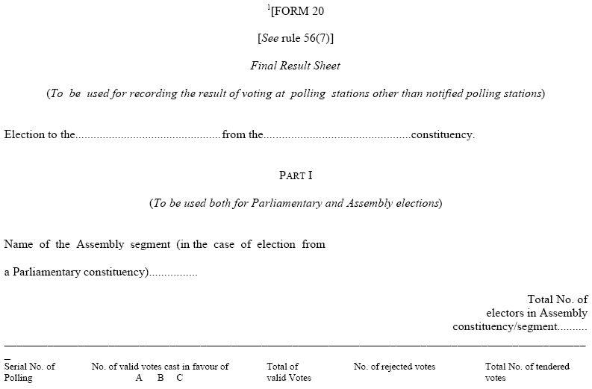
Sub Learning Objective 5: To carry out counting of votes recorded in EVMs as per ECI instructions
Annexure XLII of RO HB - Sample Final Result Sheet duly completed
43

Slide 47
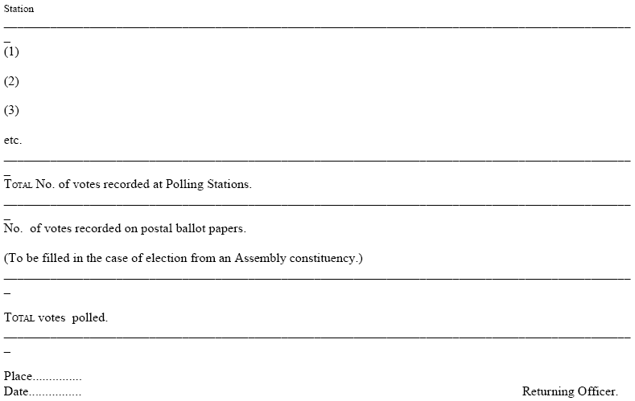
Sub Learning Objective 5: To carry out counting of votes recorded in EVMs as per ECI instructions
44

Slide 48
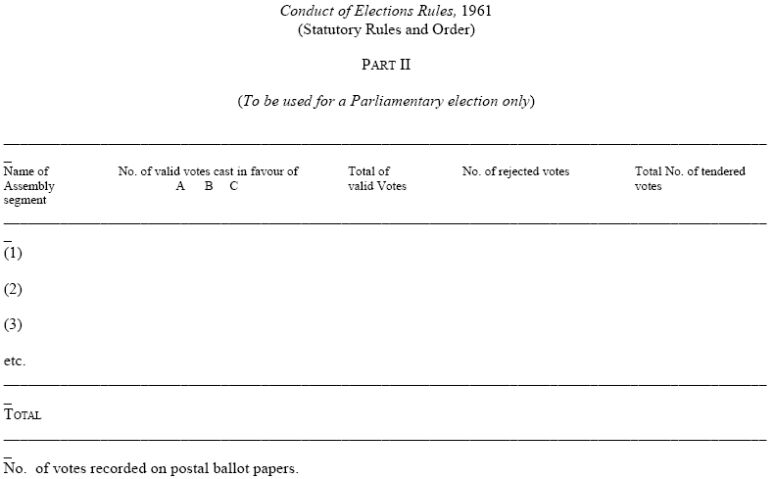
Sub Learning Objective 5: To carry out counting of votes recorded in EVMs as per ECI instructions
45

Slide 49
Sub Learning Objective 5: To carry out counting of votes recorded in EVMs as per ECI instructions
After all rounds are completed and final result sheet in FORM-20 is ready, RO SHOULD NOT immediately sign it.
Before announcing , pause for 2 min during which candidate/agent can ask for recount for PB or for all rounds for some round/s.
Ascertain how long he will take to make an application for recount in writing
If time requested is reasonable, announce exact hour and minute till which you will be waiting
Consider the grounds urged in application and decide if valid in whole or part. Reject entirely if found unreasonable/frivolous
Reason for accepting or rejecting the application should be recorded in detail
After careful recount, make changes if any in Form 20 and announce the same. Complete and sign Form 20
After observer’s clearance is obtained, announce the result

Slide 50
Sub Learning Objective 5: To carry out counting of votes recorded in EVMs as per ECI instructions
PLEASE NOTE
Penultimate round of EVM counting shall not commence unless, POSTAL BALLOT counting is over.
Your duty is to accurately count the recorded votes. Hence YOU can at any time order your staff to recount the votes.
In case the victory margin is less than total number of Postal Ballot received then re-verification of all postal ballot should be done, even if no candidate/agent has asked for it…….
…….. All the postal ballots rejected as invalid as well as counted in favour each candidate shall once again be verified and tallied in the presence of RO and OBSERVER who shall record the findings of re-verification and satisfy themselves before finalizing the result.
Entire proceeding to be VIDEOGRAPHED and CD of such videography to be kept in a sealed cover for future reference.

Slide 51
Sub Learning Objective 5: To carry out counting of votes recorded in EVMs as per ECI instructions
PLEASE NOTE (contd…)
No camera –still or video of the MEDIA except for recording of the entire counting process is allowed to be fixed inside any counting hall
Under no circumstance actual votes recorded on an EVM or ballot paper is to be photographed or covered by any audio visual coverage
Entire counting process has to be videographed without compromising the secrecy of votes and a CD thereof be kept in safe custody of DEO
Take care while doing videogrphy the focus of is on activity and not the actors
Media persons are to be taken inside counting hall in batches duly escorted by a senior officer
Arrangement should be put into place to note down the number of voters who have exercised their right under rule 49-O from the form 17-C. ( IMPORTANT POINT)

Slide 52
Sub Learning Objective 5: To carry out counting of votes recorded in EVMs as per ECI instructions
PLEASE NOTE (contd…)
Important instructions of the Commission
470/2007/PLN-I, dated 29/08/2007
51/8/7/2010-EMS, dated 20/11/2010
470/2011/EPS, dated 05/03/2011
470/TN-LA/2011, dated 05/05/2011(as amended vide letter no 470/INST/2012/EPS, dated 03/03/2012)
51/8/7/2010-EMS, dated 07/05/2011
51/8/7/2011-EMS, dated 14/02/2012
470/INST/2013/EPS dated 02.05.2013

Slide 53
Additional Points
After counting of one round is over, the EVMs have to be re-sealed .
Resealing to follow procedure as given:
Remove battery and re-seal Cand-set Section
Close outer cover of result section and reseal it
Keep CU in carrying case
Reseal Carrying case
Attach address tag containing following details:
Particulars of election
Name of constituency
Particulars of PS where CU used
S. No. of CU
Date of Poll
Date of Counting
Put SECRET SEAL in addition to your own, on all above seals
50

Slide 54
Election Papers that require to be sealed are Refer Rule 93(10 of the Conduct of Election Rules 1961:
Packets of registers of Form 17 A including voters’ slips
Packets of unused postal ballot papers with counterfoils attached thereto.
Packets of used PBs- valid or rejected- including the packets in which covers containing PSs received late are kept.
a. Packets of used and unused tendered ballot papers.
b. The packets of unused (surplus) ballot papers meant for display in BU and for use as tendered ballot Papers.
Packets of counterfoils of used PBs.
Packets of marked copies of electoral roll
Packets of declarations by electors and attestation of their signs

Slide 55
Appoint an senior officer to supervise sealing of packets. ( Pl refer previous slide)
These papers to be sealed with Secret Seal of ECI
All to be put in steel trunk
Each steel trunk locked with two locks and each lock be sealed.
EVMs and election papers thus sealed shall be deposited in safe custody of DEO without delay
DEO should ensure that these are deposited in treasury/sub-treasury under double lock, key of one will be kept with DEO himself.
The envelops sealed under R 93(1) shall not be opened and their contents inspected by any person/authority except under the order of a competent court under Secret Seal NOT to be put on locks.

Slide 56
After sealing of EVMs and election papers, YOU should draw up proceedings of counting process mentioning, inter alia,-:
* Full particulars of candidates/agents present in counting hall
* Fact that they were asked to affix seals on voting machines and packets of election papers, if they wished.
* Particulars of persons who had affixed such seal and those persons who refused to do so
* Sign the proceedings and obtain signs of the candidates/agents as present and willing to sign. The proceeding should be kept in a sealed cover along with other election papers.
53

Slide 57
After all packets are sealed, Secret Seal should be put in separate packet
Affix seals of candidates/agents if they wish
The secret Seal should be returned IMMEDIATELY after such sealing to ECI
Send through registered insured post
To be returned to Commission within 24 hours after counting is completed.

Slide 58
Sub Learning Objective 5: Declaration of results
Result declaration after:
Completing and Signing Form 20
Obtained necessary approval from ECI, wherever needed.
Obtained No Objection from ECI’s Observer
Any request for recount , if received, has been duly disposed of by a speaking order of the RO.
Declare the result by loud announcement
56

Slide 59
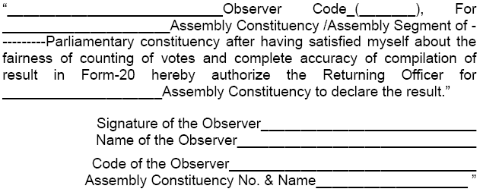
Sub Learning Objective 5: Declaration of result
RO HB: Observer’s No Objection

Slide 60
Sub Learning Objective 5: Declaration of result
Formal declaration of result should be made by YOU in either Form 21C or Form 21D :-
Form 21 C for General Election
Form 21 D for bye election
Name and address of elected candidate to be as per list of contesting candidates [FORM-7A]
Date of declaration is date on which result is declared and not date of dispatch of declaration to appropriate authorities.
Complete and certify return of election in Form 21E.
Forward signed copies of 21E to ECI & CEO of your state
You can supply copy of the 21E to candidate/agent on payment of Rs. 2/- fee [Rule 93(3)].

Slide 61
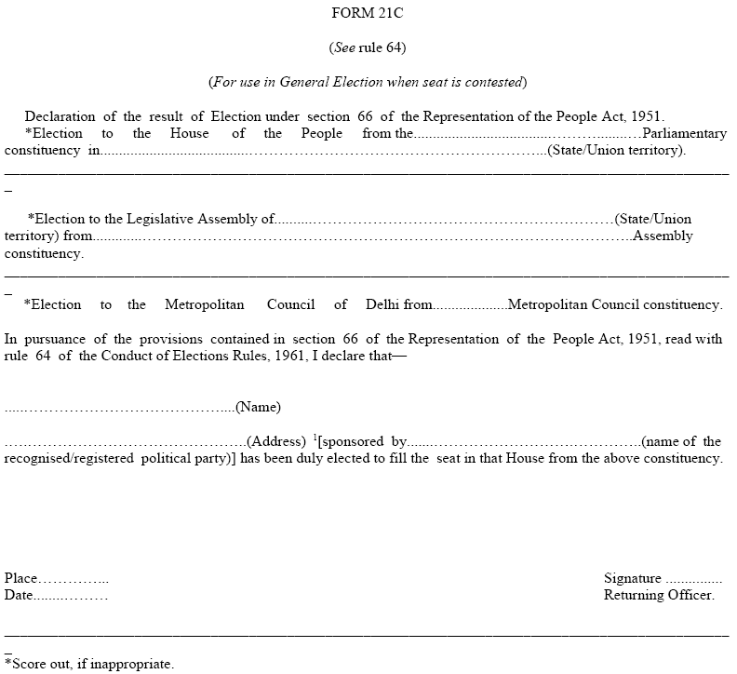
Form 21 C
59

Slide 62
Sub Learning Objective 5: Declaration of result
Send copies of Form 21C to :
ECI
CEO of state
Union Ministry of Law & Justice (Legislative Department)
State Government
Secretary to State Legislative Assembly

Slide 63
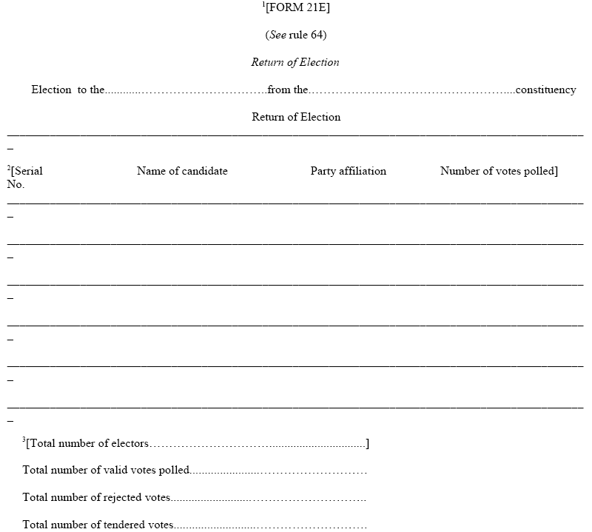
Form 21E: Return of Election

Slide 64
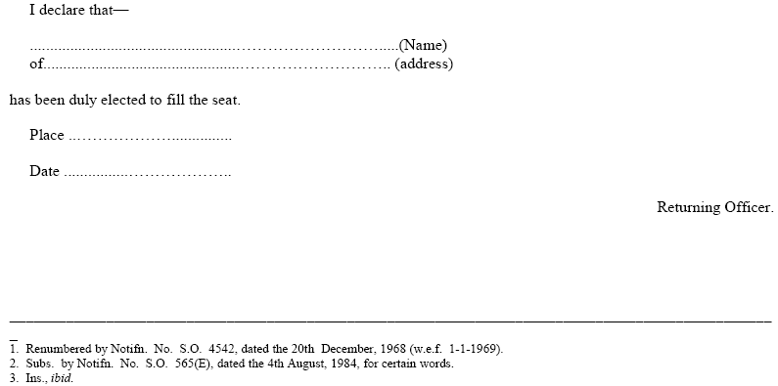
62

Slide 65
Report result of election to:
ECI by fax/ email (Without any failure)
AIR Station in State HQ
Director, Doordarshan Kendra, New Delhi
Information Officer, PIB, New Delhi
State Govt.
Chief Electoral Officer of State
Secretary of State Legislative Assembly
Director of New Services, All India Radio, New Delhi

Slide 66
Sub Learning Objective 5: Declaration of result
As soon as candidate is declared elected, you should grant to such candidate, a certificate of election in Form 22.
Only candidate or in his absence to a person duly authorized by the candidate and who is personally known to the RO, can receive the certificate of election from RO.
Only 4 persons can be present excluding the candidate or duly authorized person by the candidate for receiving the certificate of election from RO.
Obtain from candidate acknowledgement of its receipt duly signed (in any language) by the candidate.
Signature has to be attested by RO only before dispatch to the Secretary of state LA/ the Secretary General of the Parliament
Send this acknowledgement by registered Post with AD.

Slide 67
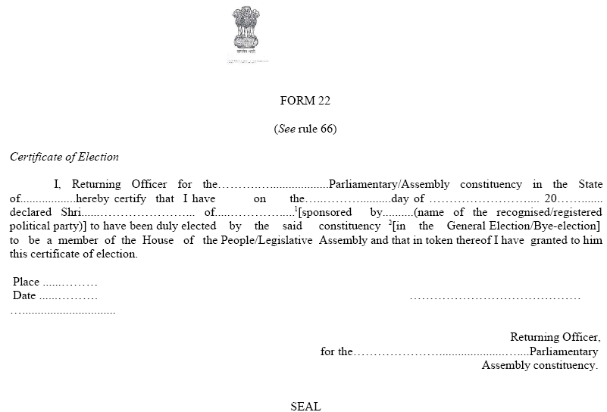
Form 22: Certificate of Election

Slide 68
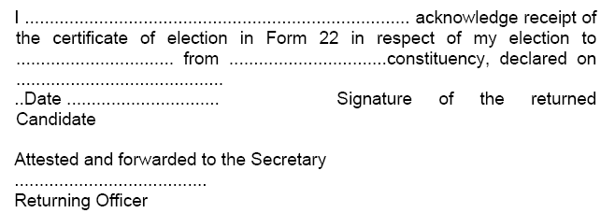
Sub Learning Objective 5: Declaration of result
Acknowledgement from returned candidate

Slide 69
Sub Learning Objective 5: Declaration of result
Certificate to be handed over to candidate and its acknowledgement is obtained immediately if s/he is present at counting
If not present, contact immediately and dispatch within a day or two
The acknowledgement of the certificate of return obtained by the RO from the candidate/ his authorized person would be required for oath taking by the returned candidate at Parliament/ Assembly
Certificate to be issued in English or Hindi or in official language of the state
Candidate can sign in any language s/he likes
Where candidate is not present in locality, certificate to be handed over to authorized person and acknowledgement signed by the same person

Slide 70
Think and reply
Whether counting of votes can start if any re-poll is going on in any PS.
Whether counting can start if there are still adjourned polls
When tendered votes are counted
Whether re-poll can be ordered after counting
Can ARO decide validity of a PB
Can an ARO receive and decide the application for recount
If the margin of win is quite thin whether ECI permission is necessary before declaring the result
A candidate got less than 1/6th of valid votes but security deposit refunded rightly, who was he ?
Who gives training to micro observers.
Some postal ballots received without seal of the attesting authority and were rejected, right or wrong ?
1st round is postal ballot round. Right or wrong.
In the Counting Hall, the Returning Officer and counting staff start the counting process sharp at the hour fixed for the purpose when all the counting agents of the candidates are also present. However, the RO skips the formality of reading aloud the provisions of u/s 128 of RP Act 1951. What can go wrong because of this?

Slide 71
ALL THE BEST!
71

Slide 72
Adjournment/ Stoppage of Counting Process
If RO has to adjourn counting for unavoidable reasons, he should seal and secure all EVMs and election papers outside the strong room using RO’s seal
Allow every candidate/agent to put seal as well as put their own locks on all room including strong room where materials are to be stored
The Observer has the power to stop counting at any time before declaration of result and power to prevent declaration of result if s/he feels:
Booth capturing has taken place at large no. of PS
Ballot papers are unlawfully taken out of your custody at any place fixed for poll/counting of votes
Election materials are intentionally/accidentally lost, damaged or destroyed or tampered to such an extent that result can’t be ascertained
S/he has no power to order recommencement of counting. This will happen on ECI’s orders.

Slide 73
THANKS
Prepared by
Shri R. K. Srivastava, Pr. Secretary, ECI
73

