Slide 1
Collection of Polling Material and EVM
Polling Materials
Checking of EVM

Slide 2
What you have to Collect?
One complete set of EVM prepared for your Polling Station.
The control unit ‘Candidate set section’ is duly sealed, address tag is firmly attached and battery is operational.
The ballot units is duly sealed and secured at two places
at right top and right bottom portions
with the seals of the Returning Officer
the address tags are firmly attached.
Ballot paper is fixed properly and slide switch is correctly aligned.
List of election materials as provided in Annexure VIII of RO Hand Book

Slide 3
What you have to Collect?
All requisite statutory and non-statutory forms
Other stationery items such as brass seal, voting compartments, outer paper seals, special tags, address tags, green paper seals, etc. to be arranged for.
Marked copy of Electoral roll along with ASD (Absent, shifted and dead) list of your polling station
ECI order on alternative documents
Photocopies of specimen signatures of the contesting candidates and their election agents
Visitor’s sheets, mock poll certificates
Additional reporting formats as prescribed by the Commission

Slide 4
Collection of Electoral Rolls - 1
3 copies (in the case of simultaneous poll 5 copies) of the relevant part of the electoral roll - complete and identical
Of that polling station
All deletions of names and corrections of clerical or other errors duly incorporated in all the copies
Serially numbered from no. 1 onwards
The printed serial numbers of the voters are not corrected with ink or otherwise
No new numbers are substituted for them
The marked copy of the electoral roll does not contain any remarks other than ‘PB’ and ‘CSV’
Deletion have been clearly marked with “DELETED’ on concerned electors
The elector role is duly signed by at least one AERO and one more official
A certificate signed by RO/ARO in following format:

Slide 5
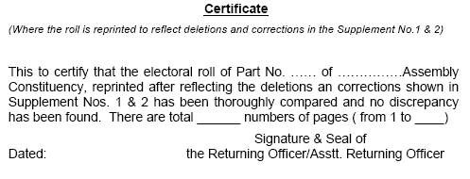
RO’s Certificate on the Roll - 1

Slide 6
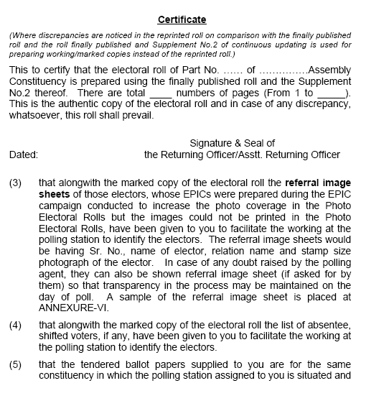
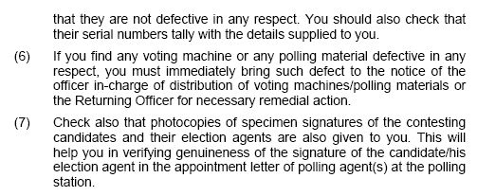
RO’s Certificate on the Roll - 2

Slide 7
Miscellaneous but Important
20 Ballot papers are supplied to be used as tendered ballot papers in the polling station. Please check that they are not defective & check their serial number.
If you find any voting machine or any polling material defective in any respect, you must immediately bring such defect to the notice of the officer in-charge of distribution of voting machines/polling materials or the Returning Officer for necessary remedial action.

Slide 8
Collection of EVMs
Ballot Unit (as per no. of candidates)
Control Unit - 1

Slide 9
Fact about EVMs
2 Manufacturers of EVM
Electronics Corporation of India Limited, Hyderabad (ECIL)
Bharat Electronics Limited, Bangalore (BEL)
2 Components of EVM
Control Unit
Ballot Unit + Interconnected by means of a cable
2 Models of EVM(either of the two model shall be used in one constituency)
Pre 2006 model
Post 2006 model

Slide 10
…Continued
EVM operates on a 6 volts battery.
Tamperproof, error free, easy to operate, portable
One Ballot Unit caters up to 16 candidates
Maximum 4 BU can be linked to 1 CU. EVM can be used for maximum 64 candidates
Ballot Units are linked in series

Slide 11
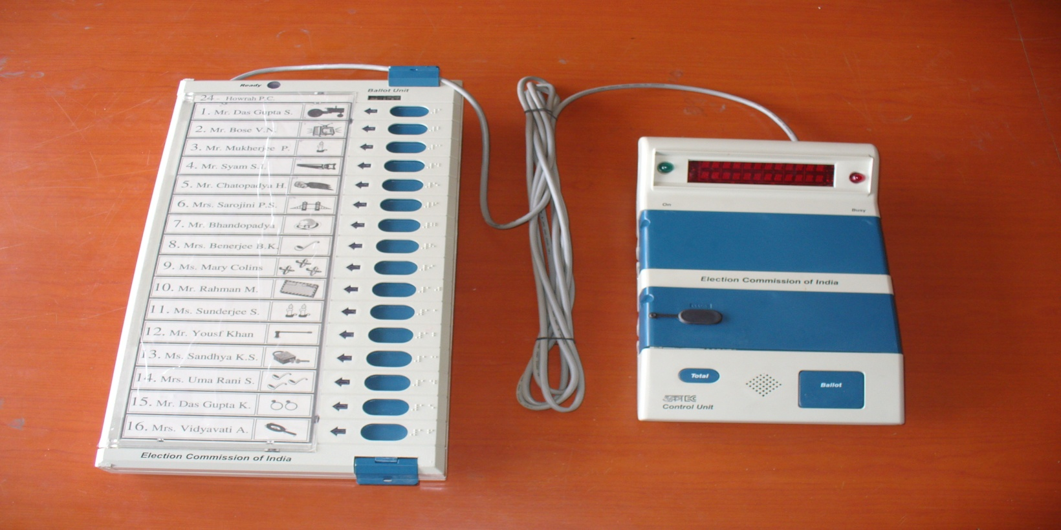
How EVM looks like?
Balloting Unit
Control Unit
Interconnecting Cable

Slide 12
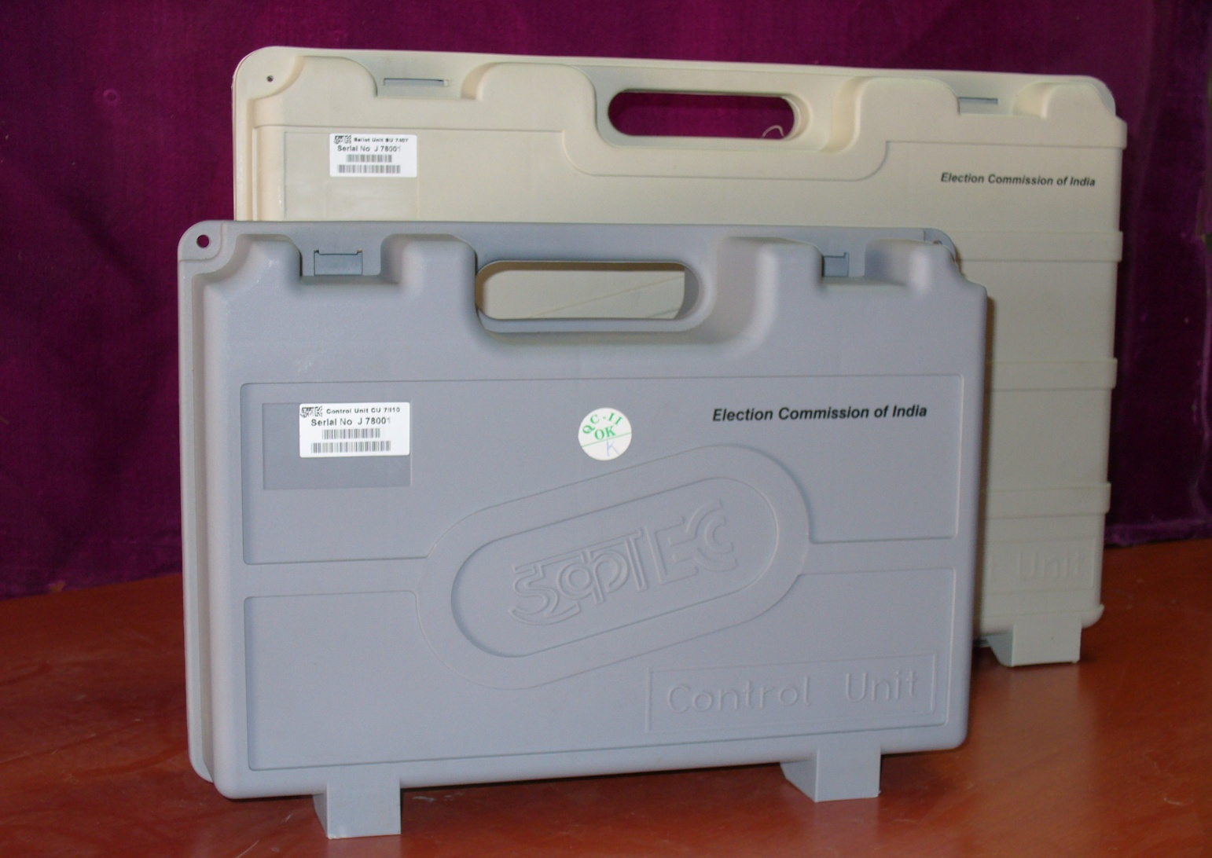
EVM Carrying Cases
Carrying Case - Control Unit
Carrying Case - Balloting Unit

Slide 13
Important Features of EVM
Unique Serial Number- Each Control Unit (CU) has unique serial number which matches with metal strip number & Bar Code on the rear side of CU
Real Time Clock (RTC) [in post 2006 EVMs]- The real time clock is used to display current time & date. The current date & time is displayed with ‘power on’ and on pressing the ‘Total’ button. Any malfunction of RTC shall be displayed by ‘CLOCK ERROR’ and all other functions will be working. This clock records time of each vote.

Slide 14
….Continued
Status of Battery Power- Battery power status is displayed. If required it also displays ‘CHANGE BATTERY’.
Power Save Mode- The unit goes into power save mode in the idle state, thus enhancing the life of power pack.
Print- The result of poll data i.e. in which time votes are cast can be printed, if required.
Braille- Molding of Braille on Ballot Unit for visually challenged voters.

Slide 15
Component of Balloting Unit
This is the unit the voter operates to exercise his / her franchise
The Interconnecting cable is permanently attached to the Balloting Unit

Slide 16
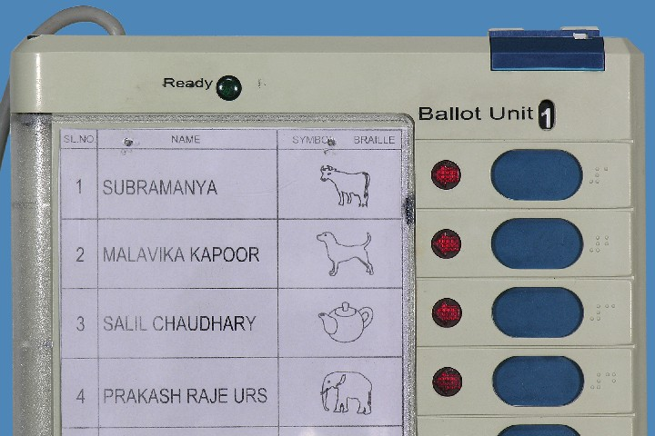
Component of Balloting Unit
Interconnecting Cable
Slide Switch Window
Ready Lamp (Green)
Numbers in Braille
Candidate’s Button
Candidate’s Lamp
Ballot Paper Screen

Slide 17
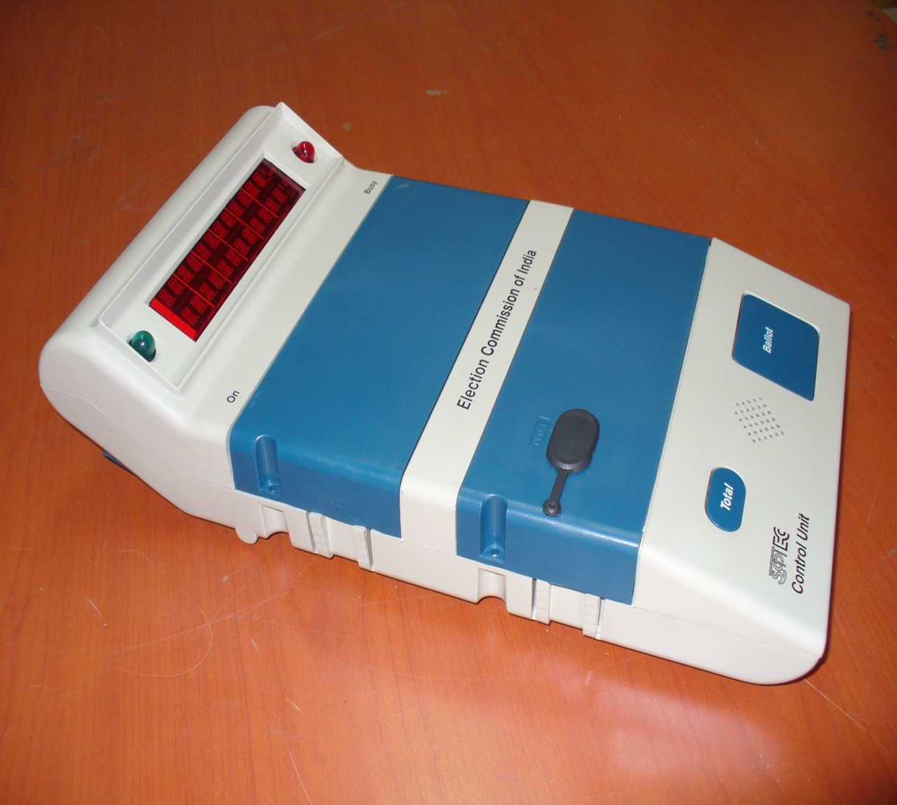
Components of Control Unit
Busy Lamp (Red)
Display Section
Candidate Set Section
Result Section
Ballot Section
Power ON Lamp (Green)

Slide 18
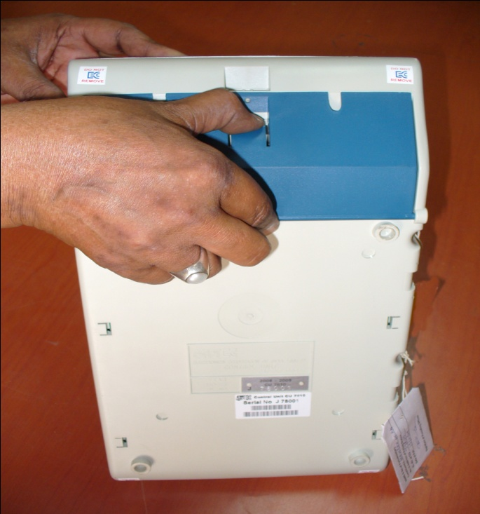
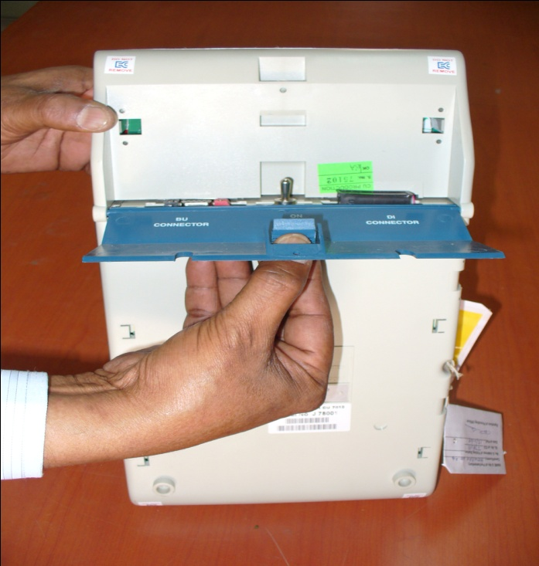
Components of Control Unit – How to open
Press Latch to release
Bottom Compartment Cover
Pull to open cover

Slide 19
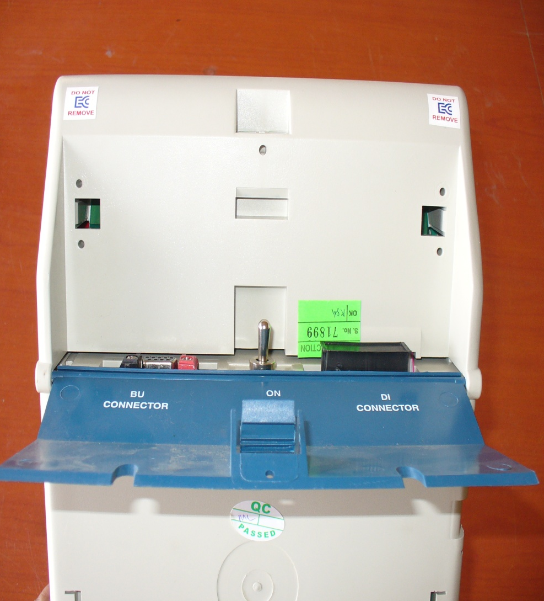
Components of Control Unit – Backside
Power Switch
Socket for connecting Data Interface.
Socket for Interconnecting Cable
of Balloting Unit

Slide 20
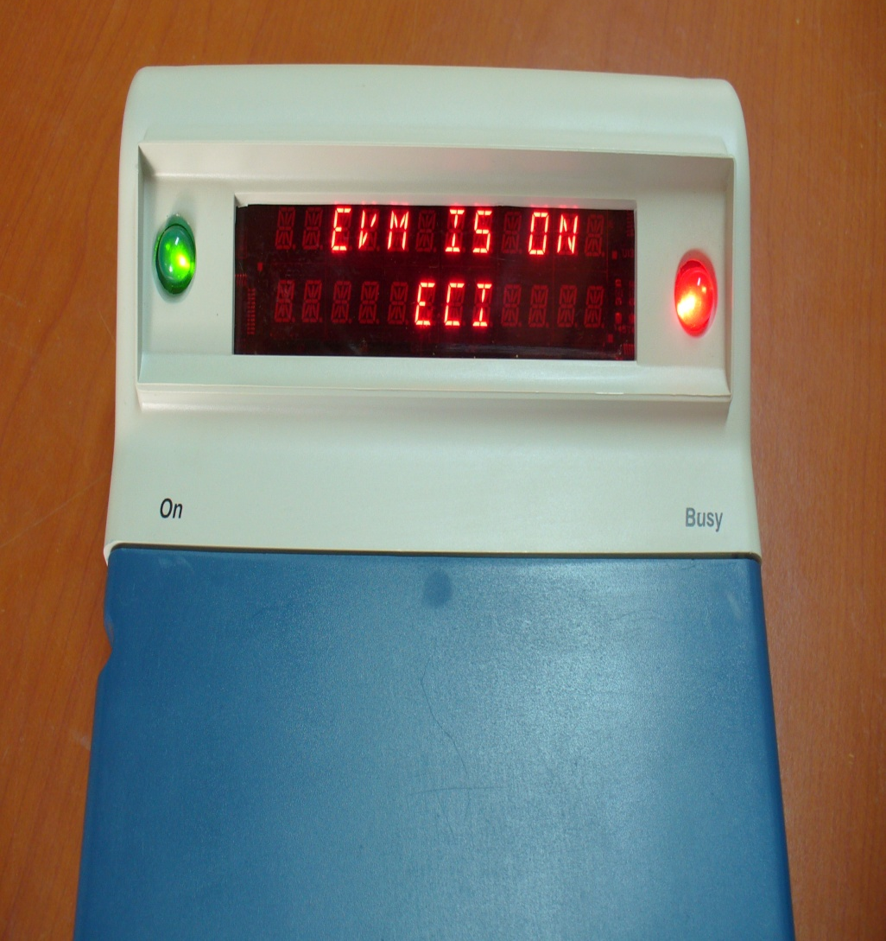
Components Control Unit – Display Section
Busy lamp glows ‘RED” when the ‘Ballot’ button is pressed by polling officer to enable the voter to cast vote. It goes off when the voter has cast his vote.
When no button is operated for 10-15 minutes, the CU goes to power save mode. Indicated by flickering of green ‘ON’ lamp in every 5 seconds.
Busy Lamp (Red)
Dual Line Digital Display Panel
Power ON Lamp (Green)

Slide 21
Meaning of various types of display
CANDIDATES 16
Indicates that the EVM is set for 16 candidates
INVALID ……….….
Indicates a button on the Control unit is pressed out of sequence
FULL ……….….
Indicates that the maximum number of votes (2000) for which the EVM is designed, has been polled
- - - - - - - ……….
Indicates that the Power Pack is weak
BATTERY HIGH
Indicates that the capacity of the Battery is High
BATTERY MEDIUM
Indicates that the capacity of the Battery is Medium

Slide 22
Meaning of various types of display
BATTERY LOW
Indicates that the capacity of the Battery is Low|
SL NO – E00001
Indicates the internal Serial number of the PCB
COMPUTING RESULT
Indicates that the RESULTS is getting computed
RESULT PDT 16-01-06
Indicates the Result and Date of the Poll
PST 09-50-20 PET 15-32-10
Indicates the Poll Starting Time and Poll End Time
CANDIDATE 06 236
Indicates that the Candidate No.6 has polled 236 votes

Slide 23
Meaning of various types of display
PRINTING
Indicates the Print operation is under progress|
CLOCK ERROR
Indicates the malfunction of Real Time Clock (RTC)
PRESSED ERROR
One of the candidates button in the Balloting Unit is either kept pressed or jammed
ERROR
The Control Unit cannot be used further
LINK ERROR
The interconnecting cable is not connected to Control Unit properly OR Slide switch position in the Balloting Unit is not set at correct number OR Balloting units have not been inter-linked in correct sequence

Slide 24
Meaning of various types of display
CU ERROR
Indicates the Control Unit is to be changed
BU-1 ERROR
Indicates the Ballot Unit-1 is to be changed
END
Indicates the end of display sequence after pressing of ‘Clear ‘ or ‘Result’ Button
TOTAL POLLED
VOTES 1487
Indicates that total number of votes polled is 1487
LINK ERROR
The interconnecting cable is not connected to Control Unit properly OR Slide switch position in the Balloting Unit is not set at correct number OR Balloting units have not been inter-linked in correct sequence

Slide 25
Meaning of various types of display
DTE 16-01-07
TME 09-43-34
Indicates the date and time
DELETING POLLED
VOTES
Indicates the deleting of polled votes from CU

Slide 26
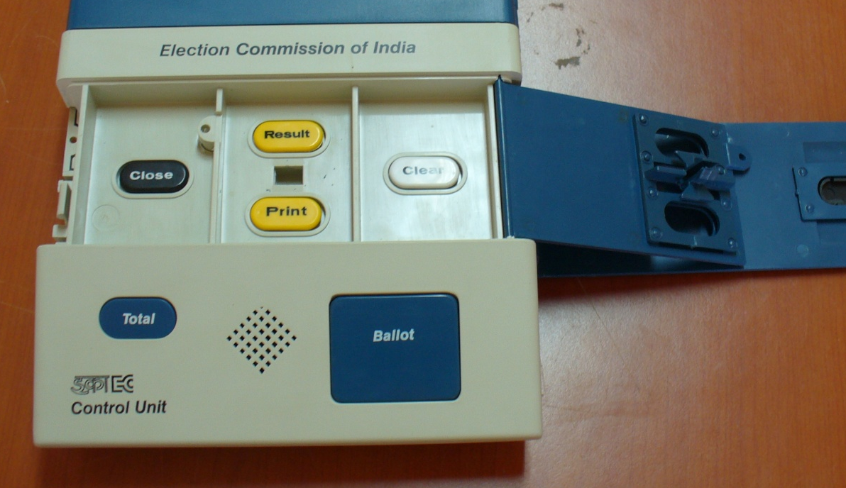
Components of Control Unit - Result Section
Close Button
Result Section
Outer Door
Result Button
Clear Button
Frame for Paper Seals
Holes to pass thread for sealing
Inner Compartment Door
Print Button
Inner Latches
Outer Door

Slide 27
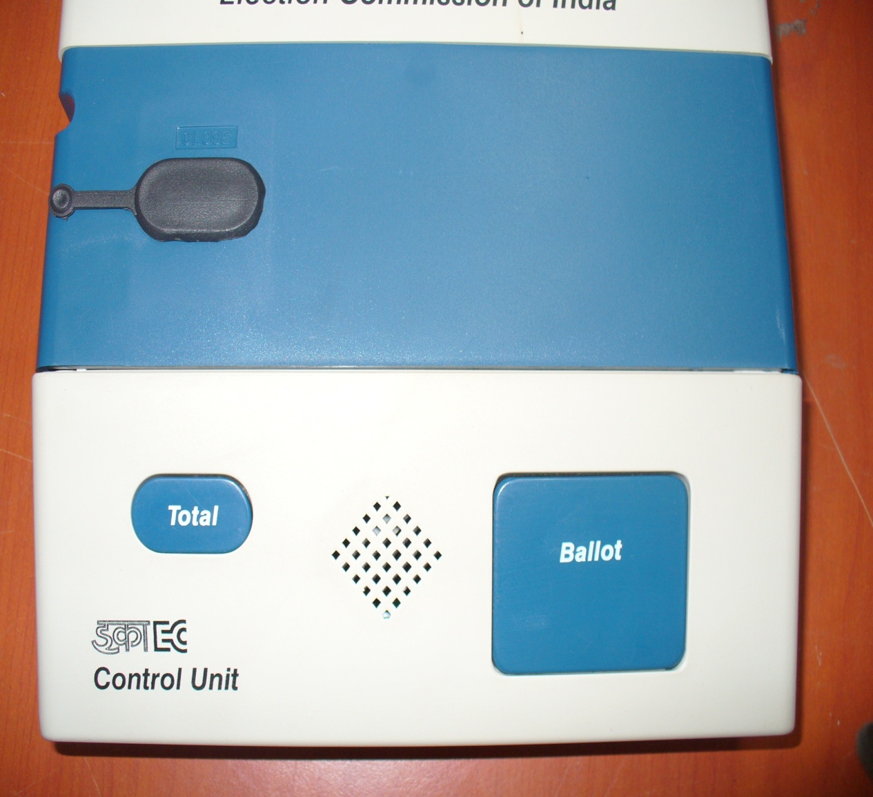
Components of Control Unit
Total Button
Buzzer
Ballot Button

Slide 28
Dos & Don’ts for EVM
Don’t
Exert undue pressure on latches, hinges etc.
Don’t
Keep EVM near heater or other hot objects
Don’t
Allow molten lac/sealing wax to fall on the EVM while sealing
Don’t
Force open the covers or doors of various sections
Don’t
Remove the Outer Paper Seal until the Control Unit is on counting table
Don’t
Remove power pack from the Control Unit used for poll
Force the connector fixed at the end of the Interconnecting cable into the connector of Control Unit in the reverse direction
Don’t
Don’t
Pull the Interconnecting cable while disconnecting it from the Control Unit without pressing the spring type clips on the hood of the connector

Slide 29
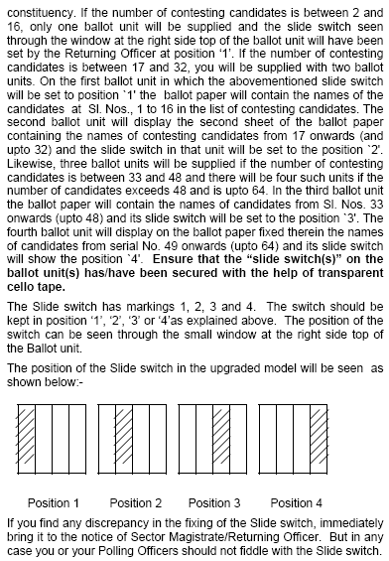
Check the EVM[Must Read carefully]

Slide 30
Collection of EVMs - 1
Checking of Voting machine
Please check from address tags attached in the CU and BU that they pertain to your polling station.
If not, bring to notice of concerned officer in-charge immediately
Please also check that all seals and tags are intact

Slide 31
Collection of EVMs - 2
‘Cand Set Section’ of control unit is duly sealed and the address tag is firmly attached.
battery installed in the ‘Cand Set Section’ of the control unit is fully operational.
This can be checked by putting the Power Switch provided in the rear compartment to `ON' position
The power switch must be put to `OFF' position.

Slide 32
Collection of EVMs - 3
Ballot paper and slide switches correctly fixed
Ballot papers fixed on units are properly aligned
Name and symbol of each candidate in line with his corresponding lamp & button

Slide 33
Collection of EVMs - 4
Thick line are in line with corresponding grooves on the ballot unit
The candidates' blue buttons masked, are visible on the ballot units = number of contesting candidates,
Remaining buttons, if any, have been masked.

Slide 34
Collection of EVMs - 5
Position of Slide Switch
No. of candidates | no of Unit | Setting position
2-16 | 1 | 1
17-32 | 2 | 1st ballot position 1 name of 1-16 candidates
 |  | 2nd Ballot position 2 Name of 17-32
33-48 | 3 | In addition to above two – 3rd ballot position 3
48-64 | 4 | In addition to above 3 4th Ballot position 4
Ensure that the slide switch (s) on the ballot Unit(s) have been secured with the help of transparent cello tap

Slide 35
Collection of Polling Material
Collect sets of all statutory and non statutory election materials one day before the date of poll
Check to ensure that the polling materials given to you belong to the polling station assigned to you
Ensure that the EVM and the Electoral Roll given to you is in order and belongs to your polling station

Slide 36
POLLING MATERIALS

Slide 37
Collection of Polling Material - 1
Register of Voters (Form 17A) - 1 Book
Voter’s Slip - 1600
Working Copies of Electoral Roll-3 for AC and 5 for PC
List of Classified Service Voters(CSV), if any – 3

Slide 38
Collection of Polling Material - 2
Address tag for CU-5
Address Tag for BU – 4
Special Tag – 3
Green paper Seals for EVM -4
Ballot Papers for Tendered Votes- 20
Indelible Ink- 2 Phials of 10CC each

Slide 39
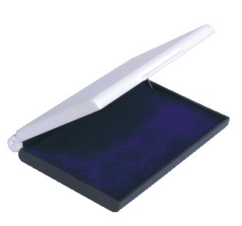
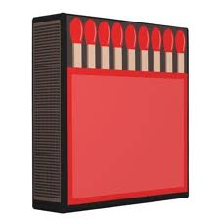
Collection of Polling Material - 3
Strip Seal -3
Metal Seal for Presiding Officer -1
Match Box -1
And sealing Wax
Presiding Officer’s Diary – 1
Distinguishing Mark Rubber stamp-1
Rubber Stamp Arrow Cross Mark-1
Stamp Pad (purple)-1

Slide 40
FORMS

Slide 41
Collection of Forms - 1
List of Contesting Candidates (form 7-A)- 2
List of Challenged Votes (Form 14) -2
List of Blind and Infirm Voters (Form 14A)- 2
List of Tendered Votes (Form 17B) -2
Account of Votes Recorded (Form 17C) -10

Slide 42
Collection of Forms - 2
Record of Paper Seals used -2
Receipt Book for deposit of challenged votes fee- 1 book
Letter to SHO – 4
Declaration by the Presiding Officer before the Commencement of Poll & End of Poll (Part I to IV) – 2
Declaration by Elector about his age – 2

Slide 43
Collection of Forms - 3
List of Electors who voted after giving declaration/refused to give declaration – 10
Declaration by the companion of blind and infirm voters-10
Passes for Polling agents- @ 2 for each candidate
Visit Sheet – 2
Format for Presiding Officer’s Additional 16-Point report to be submitted to Constituency Observer/ RO

Slide 44
ENVELOPES

Slide 45
Collection of Envelops - 1
For smaller envelopes (Statutory Covers)(SE-8)- 1
For marked copy of electoral rolls (SE-8)-1
For other copies of electoral rolls (SE-8)-1
For tendered ballot paper & Tendered Voters list-1

Slide 46
Collection of Envelops - 2
For Declaration by the Presiding Officer before commencement of poll and at end of poll (SE-7)-1
For account of votes recorded (SE-5)-1
For list of challenged votes (SE-5) -1
For unused and spoiled paper seals (SE-5)-1

Slide 47
Collection of Envelops - 3
For appointment letters of polling agents (SE-6)-1
For list of blind and infirm voters (SE-5) -1
For Presiding Officer’s Diary (SE-6)-1
For Election Duty Certificate (SE-5) -1(in case of Parliament Election)

Slide 48
Collection of Envelops - 4
For receipt book and cash forfeited (SE-6)-1
For declaration of comparisons (SE-5) -1
For smaller envelopes (others) (SE-7) -1
For Register of Voters (17A) containing signatures of voters (SE-8) - 1

Slide 49
Collection of Envelops - 5
Cover for PrO’s brief record under Rule 40 (SE-6) -1
Plain Envelopes (SE-7)-2 (SE-8)-3
For unused ballot papers (SE-7) -5
For any other paper that RO has decided to keep in sealed cover- 1

Slide 50
Collection of Envelops - 6
Cover for unused and damaged special tag (SE-7) -1
Cover for unused and damaged strip seal (SE-7)-1
Wherever envelopes are smaller in size, packing paper to be used with purpose written in red ink

Slide 51
SIGN BOARDS
Entry
Polling Officer
Polling Agent
Miscellaneous Notice Specifying area etc. required by Rule 30(1)(a)
Presiding Officer
Exit

Slide 52
STATIONERY

Slide 53
Collection of Stationery - 1
Ordinary pencil -1
Ball pen – 3 Blue +1 Red
Blank Paper – 8 sheets
Pins – 25 pieces

Slide 54
Collection of Stationery - 2
Material for voting compartment – 2+2=4
Gum Paste- 1 bottle
Blade - 1
Sealing Wax – 6 sticks

Slide 55
Collection of Stationery - 3
Thin Twine thread – 20 m
Metal rule – 1
Carbon Paper – 3
Candles – 4 sticks

Slide 56
Collection of Stationery - 4
Cloth of rag for removing oil etc. - 3
Cup/Empty tin/plastic box for holding indelible ink bottle – 1
Drawing pins- 24 pieces
Packing paper – 2 sheets

Slide 57
Collection of Stationery - 5
Rubber Bands – 20 pieces
Cello Tape - 1
Checklist – 2

Slide 58
THANKS

