Slide 1
Learning Objective : To facilitate preparation of the District Election Management Plan (DEMP)

Slide 2
Learning Objective : To facilitate preparation of the District Election Management Plan (DEMP)
1
To list components of the DEMP
2
To list major requisite information
3
To list steps of Process of Preparation

Slide 3
Sub Learning Objective 1: Components of District Election Management Plan
DEMP
District Profile
Elector Details
Polling Stations
Logistic Plan
Movement Plan
Police Deployment Plan
Communication Plan
Counting Plan
Provision of Polling Staff Welfare
SVEEP

Slide 4

Sub Learning Objective 2: Major Requisite Information for DEMP
Polling Stations
Constituency wise no. of polling stations
Polling stations categorized by no. of voters
Logistic Plan
Assess manpower requirement at various levels
No. of eligible personnel and no. of personnel required
Movement Plan
Polling Stations accessible by vehicles
Polling Stations without telephone lines
Compilation of particulars of officials/officers working at govt. offices/ PSUs
Movement plan for polling parties with route charts, sector wise
Sketch Map of Constituency showing sector routes
Assessment of vehicle requirements

Slide 5

Sub Learning Objective 2: Major Requisite Information for DEMP
Sketch Map of Constituency showing Sector routes
Polling Station-4
Polling Station-1
Various Routes to reach Polling stations
40 km - 1 Hr.
Polling Station-5
Alternate Routes to reach Polling stations
20 km - 30 Min.
Polling Station-3
Shortest Routes to reach Polling stations
Polling Station-2
5 km - 10 Min.
Polling Station-6
Road Condition, River, Nala, Bridge
10 km - 20 Min.
Approximate time to reach and distances

Slide 6
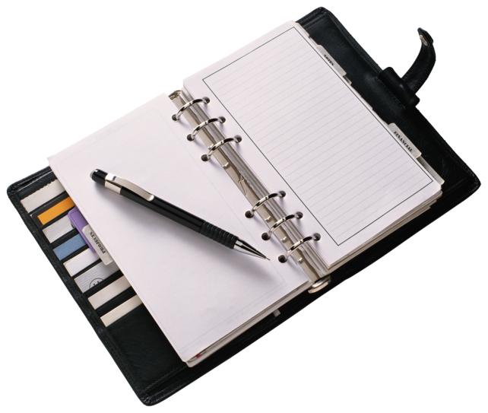
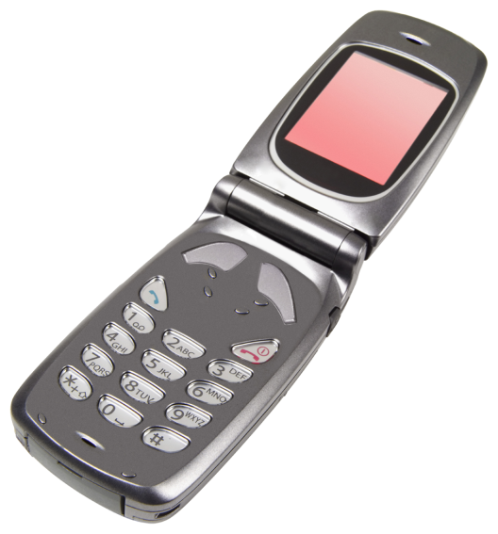
Sub Learning Objective 2: Major Requisite Information for DEMP
Police Deployment Plan
Assessment of Requirement of police personnel (various ranks)
For sector movement and to man polling stations
Communication Plan
List of landline and cellular connections available near each PS along with particulars of contact person
List of polling personnel/ SO with cellular numbers
Prepare return journey for polled EVMs/Polling material, their storage and security plan till counting
Plan mode of communication such as VHF/HF to ensure connectivity in mobile shadow regions

Slide 7
Sub Learning Objective 2: Major Requisite Information for DEMP
Counting Plan
Identify places for storage of EVMs & Polling materials
Assess Counting Staff availability
Provision for Polling Staff Welfare
Name, Designation and contact details of nodal officer in charge of ensuring polling personnel welfare
Clear communication of training schedule, dispatching schedule
Submit Proposal to CEO for approval from ECI in advance
Detail other logistics, media and security arrangements
Basic amenities at training and dispatching venue
Facilities at PS to be physically verified and ensured - Adequate facilities for food, refreshments and medical requirements to be made
Immediate relieving from duty after handover of EVMs and polling materials
Advance measures to ensure transport facilities for staff
Special facilities/measures for physically challenged, female polling personnel, death of personnel on duty

Slide 8

Sub Learning Objective 2: Major Requisite Information for DEMP
Systematic Voters’ Education And Electoral Participation
It handles work related to all aspects of Voters’ Awareness & Education aimed towards improving Electoral Participation and building up a culture of participative democracy among citizens

Slide 9
Sub Learning Objective 3: Process of Preparation
SO collects field data
ARO compiles the data
ARO submits preliminary report to RO
RO checks and makes modifications as required
RO submits to DEO
DEO finalizes the plan
DEMP sent to CEO who suggests changes, if any

Slide 10



Sub Learning Objective 3: Process of Preparation
Final Responsibility of 100% testing of all components of communication plan lies with District administration. Checking of:
  Riders/ Messengers
  Mobiles
  Landlines
  Fax, if available
  Wireless handset
  Satellite phones
  Any other means of communication identified
DEOs can appoint nodal officer for matters such as:
EVMs
Legal cases
Receiving and dispatching centres
Counting centres
Training
Polling personnel
Transportation (ideally someone from RTO)
Election Materials
Observers
Media Interface

Slide 11
ECI Instructions

Slide 12
District Election Plan
(ECI No. 464/INST/2008-EPS dt. 24.10.08)
Prepare a district profile giving details of the following: -
(a) important officials and their telephone numbers,
(b) geography,
(c) demography,
(d) administrative units/assembly segments,
(e) general law and order with constituency specific details and
(f) past electoral offences

Slide 13
Information regarding electors be ready in advance:-
(a) about sex ratio (form 1B & 1C)
(b) Voter population ratio (form 2C)
(c) Inclusion & Deletion (form 3B and 3C)
(d) EPIC coverage (Form 5B & 5C)
[e] Age cohort analysis, AC wise
[f] Absentee voters with and without family links details/ analysis
[g] ESR details and action taken.

Slide 14
Polling Stations :–
Details -
(a) Constituency wise No. of PSs, Nos of polling locations, Categorized by No. of voters etc.,
(b) PSs accessible by vehicle, their distance from road, list of PSs without telephone lines - Tel. No. of each PS.
(c) Vulnerable villages/Hamlets - List in format.

Slide 15
Movement Plan of Polling personnel
Man power requirement to be assessed for appointment as sector/zonal magistrates, PrOs, POs, etc., - complete database of particulars of officers/ officials working in all central/State Govt. officers, PSUs etc.,
(a) Sector movement plan - Plan of movement of polling parties/security forces, SOs with detailed route chart indicating PSs - Sketch map of constituency showing sectors and PSs.

Slide 16
(b) Requirement of vehicle etc - Buses, LMVs and Heavy vehicles for polling parties, special executive magistrates, security forces etc - Assessment well in advance.
District Security Plan - As per ECI No. 64/INST/2008-EPS dt. 24.10.2008.
Communication Plan -
(a) For polling stations - Prepare list of telephone nos. available in/nearby each PS along with particulars of contact persons/ runners/ police stations/ police posts.

Slide 17
(b) Prepare list of telephone nos/mobile nos of PrOs, SOs, Spl. Executive Magistrates.
(c) Mode of communication such as VHF/HF linkage to ensure connectivity with each PS on poll day where no landline/mobile is available.
(d) Putting all contact Nos. and details related to election officials and polling stations on CEO website along with polling station-wise vulnerability / criticality status.
Counting Plan -
(a) Identify the place for polled EVMs and counting of votes.
(b) Proposals of counting centres through CEO to ECI for approval.
(c) Assess the requirement of counting staff.
(d) Other logistic arrangements.
(e) Media arrangements.
(f) Security arrangements
(g) Communication and furnishing the data.

Slide 18
Assembly segment wise Election Plan
(ECI No. 464/INST/2008-EPS dt. 24.10.08)
(a) Details of PSs - Total number - categorization of PSs urban/ rural/ polling locations.
(b) Sectors to be formed - one sector (cluster of PSs) should fall on one common road.

Slide 19
Sector Management Plan
(ECI No. 464/INST/2008-EPS dt. 24.10.08)
(a) Sectors to be formed in advance so that immediately after the announcement of elections, the SOs could be appointed.
(b) Area of the Sector Officers/Zonal Magistrates and police mobile should be same.

Slide 20
Other issues
Selection of buildings/premises for various activities –
a)For training classes to polling personnel etc.,.
b)For checking and preparation of EVMs and their storage.
c)For storage of EVMs to be used in training
d)For storage of EVMs AC wise after first randomization.
e)For Dispersal centers
f)For safe custody of polled EVMs and counting of votes.
(Refer ECI Circular No. 51/8/7/2012-EMS dated 19th January, 2013 for a) to e) above)
g)For boarding and lodging of central forces/ outside police forces
h)For boarding and lodging of polling personnel, if required.

Slide 21
Control Room - To be well equipped
MCC Teams - complaint monitoring system.
(i) Nodal Officer
(ii) Formation of MCC team AC wise.
(iii) Register to be maintained.
ATR and daily monitoring
IT related activities - a technical team comprising at least one programmer and two data entry operators must be available full time at district level (ECI No. PPS/DEC/ JP/2006 dated 15-12-2006)

Slide 22
Deputing staff and formation of various cells for general arrangements - Duties to be assigned for following events: -
S.No. Event S.No. Event .
(i) Polling personnel (ii) Facilitation centre
(Helpline & Control Room)
(iii) Polling stations (iv) Media centre/cell
(v) Electoral Roll (vi) EVMs
(vii) Transportation (viii) Complaint monitoring
arrangements
(ix) Printing of Postal (x) Election Expenses
Ballots and EVM ballots
(xi) Issue of Postal Ballots/ (xii) Procurement and distri-
EDC bution of election materials

Slide 23
Sl. No. Event Sl. No. Event .
(xiii) Route Chart preparation (xiv) Liasoning with Observers
(sector movement plan)
(xv) Counting Staff (xvi) Issue of Identity Card
(xvii) Training (xviii) Micro Observers
(xix) Polling personnel welfare (xx) Computerization/ Randomization
(xxi) Communication plan (xxii) Arrangements at Distribution Centre, reception Centre,
Counting Centre
(xxiii) Vulnerability Mapping; Critical Polling stations
(xxiv) Law and Order (xxv) Model Code of conduct and videography
(xxvi) Police Personnel (xxvii) Zonal officer/Sector officers
(xxviii) Statistical Data Cell
(xxix) Distribution of voter slip

Slide 24
Meeting with political parties/Standing Committee - Meeting as often as may be convenient after declaration of election - Appeal to cooperate in the observance of model code of conduct for free and fair elections and to maintain law and order - Minutes be drawn - Not to be used as mere formality.

Slide 25
Media Cell: -
      Nodal Officer
      Holding meetings with media.
      Giving information on nominations, affidavits, etc and other events.
- Sharing other information
      Coverage on poll day
      Coverage on counting day
      Authority letters.

Slide 26
Facilities for Observers
[ECI's No. 464/OBS/2007/PLN-I dt. 9-1-2007 and No. 464/INST/ 2007/PLN-I dt. 12.10.2007]
Boarding, lodging, transport and security to be arranged by DEO.
Stationary, wireless communication, guide and secretarial assistance be provided.
Contingency expenditure, if any, incurred by observer will also be reimbursed
Fax machine of district administration be used by Observer on a priority basis and confidentiality be maintained
One telephone line is sufficient for use of more than one Observer being housed in same premises.

Slide 27
STD telephone with fax facility at counting centers.
Give constituency maps, list of PSs, table of contents of electoral rolls, telephone numbers, book-let containing plan of election and counting of votes.
Proper transport from nearest railway station/airport to constituency.
No Guard of Honour - No escort car/pilot or advance pilot.
Place of stay, phone number and dates of visits of Observer should be publicised.
Food arrangements by district administration
Every Observer will be provided a video camera and a videographer from the day he reaches the constituency.

Slide 28
If suitable Government Guest Houses not available provide alternative, accommodation in consultation with CEO.
TA / DA - be drawn from parental ministry / department / office

Slide 29
Restrictions on the Printing of pamphlets, posters etc.,
[ECI's No. 3/9(ES008)94-JS II/5196 dt. 2.9.94, No. 3/9/2004/JS II dt. 24.8.2004 & No. 3/9/2007/JS II dt. 16.10.2007 and Sec. 127A of RP Act 1951]
Ensure whether printers and publishers are complying with the provisions of Sec. 127A of R. P Act, 1951.
All the printing presses shall be informed within 3 days of announcement of election in writing by the District Magistrate to furnish information and printed material as required U/s 127A of RP Act 1951 - Attention towards provisions of Sec. 77(1) and 127A of R.P. Act and sec. 171 H of IPC and ECI's directions may also be drawn.

Slide 30
Four copies of such printed material along with declaration of the publisher shall be furnished to DM/DEO by the printer within 3 days of printing.
List of all the election pamphlets, posters etc shall be exhibited on the notice board of DM/DEO.
Surrogate advertisements in print media for/against a political party/candidate - Expenditure involved in such advertisement has to be added to account of election expenses u/s 77(1), hence required to be maintained - Sec. 171H of IPC prohibits expenditure without authority from the candidate.
Strict action on violation of the provisions of Sec. 77(1) and 127A of RP Act, 1951, 171H of IPC and Commission's directions.
A press note should be issued drawing attention towards provisions of Sec. 77(1) and 127A of RP Act, 1951 and Sec. 171H of IPC.
A report be sent to CEO after completion of election.

Slide 31
Feed back about "Dummy Candidates" and measures to be taken in this regard (ECI's No. 464/INST/2008/EPS dt. 7.1.2009)
Actual use of vehicles permitted for campaigning be reviewed - Video recording and collecting evidence - Issuing notice.
Before giving permits of vehicles on poll day dummy factor should be considered.
Appointment of polling agents should be tracked.
Close watch on counting agents.

Slide 32
On misuse of permitted vehicle, action u/s 171H IPC to be taken.
On misuse of vehicle authorized for dummy candidate, notice be given to include the expenditure of the candidate who misused the vehicle for his campaigning.

Slide 33
CERTAIN ORDERS TO BE ISSUED BY THE DM
( 464/instruCtions/ 2009/EPS dated 01.09.2009)
  Suspension of Arms license.
  Issue of prohibitory orders under section 144 Cr. PC in certain cases (If required).
  Issue of order under defacement of property (Prevention Act).
  Prohibition of sale of liquor (declaration of dry day).
  Order relating to use of loudspeakers.
  Declaration poll day as local holiday (If required).
  Inviting the attention of Govt. Servants towards relevant provisions of MCC and conduct rules.
  Appointment of Sector Magistrate.
*Appointment of Special Executive Magistrates under CrPC for proper Conduct of Elections (eg. Sector/ Zonal Magistrates for SST and FST).

Slide 34
  Requisition orders regarding buildings for Polling Stations, Counting Centres, Distribution centres, Reception centres etc..
  Requisition order of vehicles.
  Issuing orders to the Petrol pump owners for keeping reserve stock of POL.
Sending various statistical information and reports to CEO - To send information as per detail given in Annexure-1 of HB of ROs).

Slide 35
THANKS

