Slide 1
Training of Counting staff

Slide 2
Sub Learning Objective 3: To ensure infrastructure and security arrangements at counting centres

Slide 3
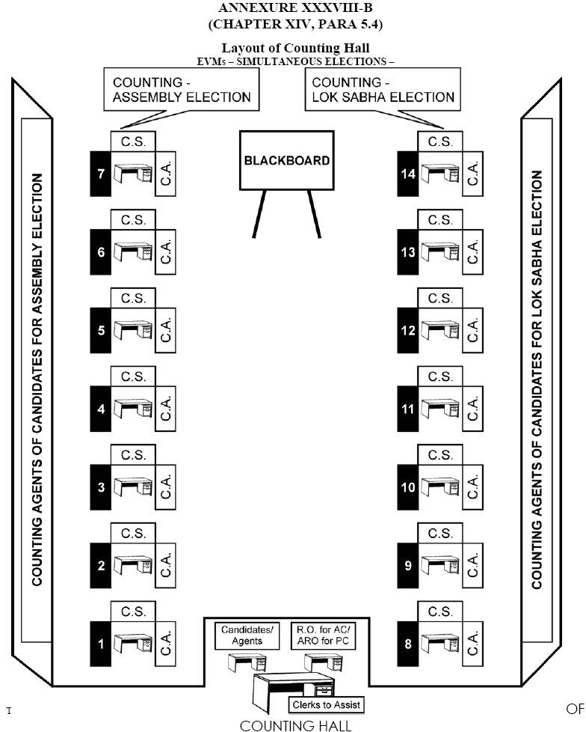
Layout of Counting Centers

Slide 4
PERSONS ALLOWED INTO COUNTING HALL (Para 15.13 of HB of RO)
Counting supervisors and assistants
Persons authorized by ECI
Public servants on duty in connection with election
Candidates, their election agents and counting agents
Check that no one else has entered hall

Slide 5
PERSONS NOT ALLOWED INTO COUNTING HALL
Police officers/security personnel unless RO calls them inside to maintain law & order
Ministers, State Ministers, Dy. Ministers of Union & state unless they are candidates
The above cannot be appointed as election or counting or polling agent of candidate as they require security
Counting agents cannot enter unless s/he has submitted 2nd copy of appointment letter after completing and signing declaration

Slide 6
PRIORITY IN SEATING IN COUNTING HALL
(subject to seating capacity)
(Para 15.14.1 of HB of RO)
1. Agents of candidates of recognized national parties
2. Agents of candidates of recognized state parties
3. Agents of candidates of recognized state parties of other states permitted to use reserve symbol
4. Agents of candidates of registered unrecognized parties
5. Agents of Independents Candidates

Slide 7
DISCIPLINE & DECORUM IN COUNTING HALL
Agents to keep seated at allotted table. No one is allowed to carry mobile phones except RO/ Observer
Agents shouldn’t be allowed to move about hall. However, Candidates/ Election Agents can move around hall
Only one person – either candidate or agent to be present at a table on behalf of contesting candidate
If RO doubts any person he can have him/her searched, even if they possess valid authorization letter
Police officials posted at doors of counting hall
No one can enter or leave hall without RO’s permission
RO can send anyone out of hall if they disobey RO’s orders

Slide 8
Counting of Postal ballots
Under Rule 54A, postal ballot papers are to be counted first so in all cases, 1st round shall be for PBs only. (However, it has to be completed before start of penultimate round of EVM counting).
Counting of votes in EVM can be commenced 30 minutes after start of Postal Ballot counting, even if the latter is not completed. Not necessary to wait further.
Counting of PBs to be done at RO’s table only.
One ARO will be specifically designated for supporting the RO for postal ballots.
All PBs received before the hour set for commencement of counting shall be brought before RO and counted.
Covers in Form 13C received after fixed hour shall not be opened. They should be rejected and kept in sealed separate packets with particulars noted on it.
Covers in Form 13C received in time to be opened one by one.

Slide 9
Counting of Postal ballots
Take out declaration in Form 13A and cover in Form 13B. If no 13 A is found in the cover, then reject.
Scrutinize Declaration
Reject if not duly signed/attested by competent authority
Also reject if substantially defective or Serial Number in 13 A and 13 B does not match.
Each rejected cover to be endorsed suitably; declaration & cover Form 13B placed in Form 13C
All such covers to be kept separately and sealed with particulars noted on top for easy identification
All declarations in order to be kept together and sealed so that secrecy of ballot is not violated
This should be done before Form 13B containing ballot paper is opened
Now open 13B and scrutinize Postal Ballot Paper and take decisions

Slide 10
Counting of Postal ballots
Count valid votes and credit each candidate with votes given to him
Calculate total No. of votes received by each candidate
This should be entered in Result Sheet in Form 20 in appropriate location
Announce this result aloud for information of candidates
All valid and rejected PB papers to be bundled, packed, sealed with RO’s seal, candidates’ seal if they wish and then ECI Secret seal
Particulars (name of constituency, date of counting, brief description of contents) on sealed packet

Slide 11
Counting of Postal ballots
Postal Ballot Paper rejected if:
No vote is recorded
Votes given for more than one candidate
It is spurious ballot paper
It is damaged/mutilated that its doubtful if PB is genuine
Not returned in cover sent along with it to elector by you
Mark placed in such a way that it is doubtful for which candidate vote has been given
It bears mark apart from vote or writing by which voter can be identified
No particular mark as per law to be made by voter to record vote on PB
Any mark is valid if it is clear beyond reasonable doubt in favor of which candidate vote has been given
It should not be rejected if mark has been made more than once to clarify choice
Sealing of packets should be done using RO as well as Commission’s secret seal. Candidates also allowed to use their seals.

Slide 12
Counting of votes recorded in EVMs
EVMs to be distributed sequentially, i.e. PS no. 1 to Table 1 and so on. Nodal officer to ensure.
Keep account of such distribution with you
Only CU required for Counting . BU to be brought into hall only if inspection required
Along with CU, sealed cover containing Form 17C (Account of Votes) to be brought to counting table.
Remove the seals from carrying case, take out CU. Place on table for inspection of seals by Candidates/ agents before counting of votes.
If seal is properly intact and there is no tampering, votes will be counted.
Proceed further
Decide if clerical errors or actually tampered with. If tampered with, keep aside and inform ECI immediately
When taken out of carrying case, check:
That it is the same CU supplied to the PS
Seal on Cand set Section is intact.
Outer Strip Seal in Result Section
Special Tag in Result Section
S. No. on green paper seal to tally with paper seal account prepared by PrO in Form 17C:Part I: Item 9.

Slide 13
Counting of votes recorded in EVMs
Switch ‘On’
Press the ‘Total’ button and check whether total vote shown are matching with part-I of Form 17C
Pierce paper seal to press Result I button provided in inner cover of result section
Total no. of votes for each candidate will be displayed for that PS. Lift the unit and show it to all agents so that they can note down.
Counting supervisor to note result in Part –II – Result of Counting of Form 17C.
If required, press again to show result to candidates/agents
After result noted, close cover of result section and Switch “OFF” CU
If not, check if clerical mistake. In case, the RO can not resolve the matter and there is dispute, keep the EVM aside and report the matter to ECI for further direction

Slide 14
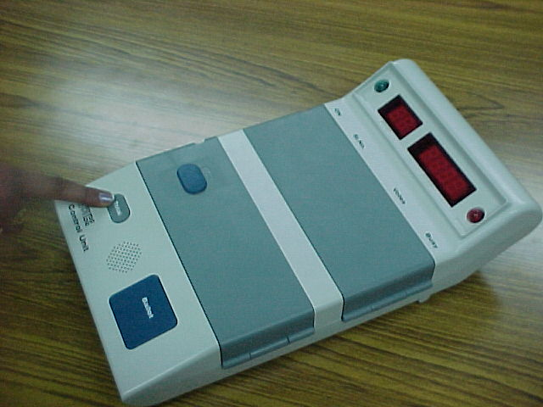
Counting Procedure
Piercing of Paper Seal
(Contd.)
To find out whether the Power pack / Battery is working or not, press TOTAL Button
After getting ready to note down the result, PIERCE the green paper seal over RESULT-1 Button and reach RESULT-1 Button. It is not necessary to open INNER COMPARTMENT
Procedure at the Counting Place

Slide 15
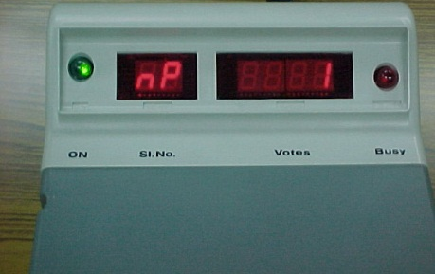
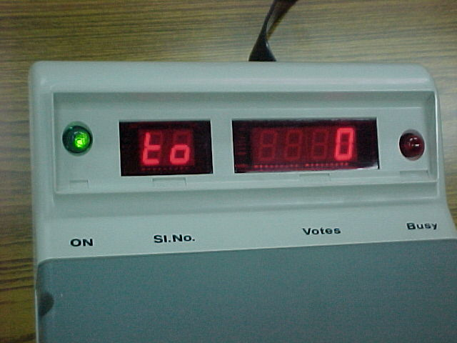
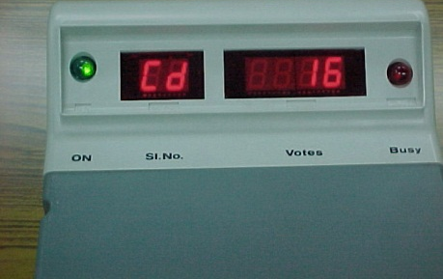
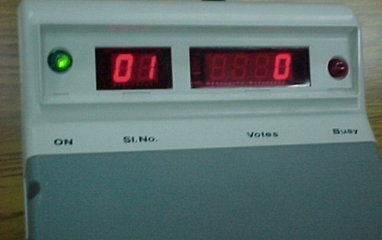
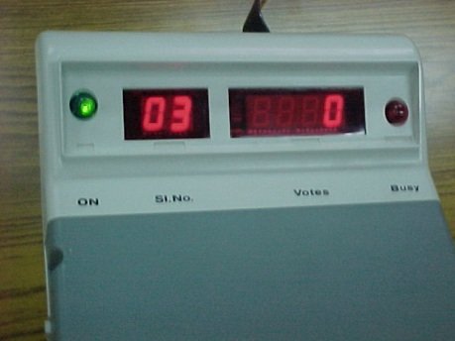
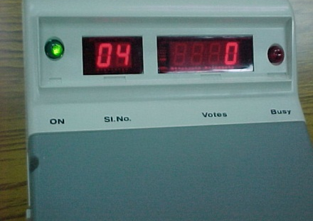
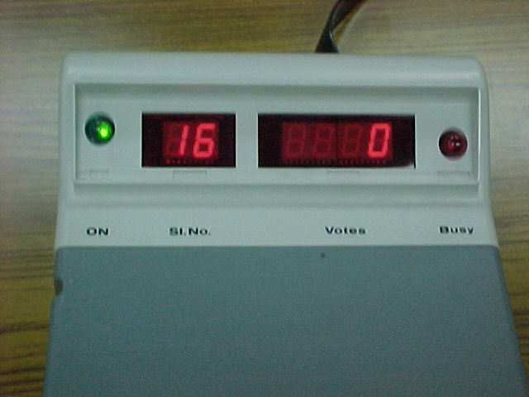
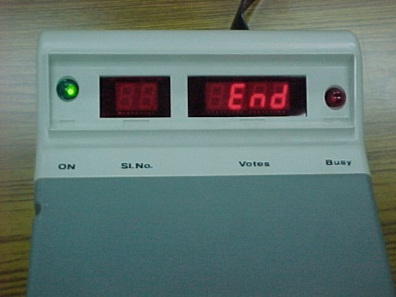
Counting Procedure
Result Display
(Contd.)
Press RESULT-1 Button. Note down the result.
Procedure at the Counting Place

Slide 16
Tabulate Results of EVMs
Counting Supervisor to tally Result noted in part II of Form 17C and that noted down in Item 5: Part I: Form 17C
After completing form, counting supervisor to sign it
Get candidates’/agents’ signatures present at table
He should then hand over duly completed 17C to RO.
RO to countersign in part-II of 17C after satisfying himself
Thereafter 17C should be sent to the Officer compiling final result in Form 20
On basis of individual Form 17C, RO to get prepared a round wise statement in the prescribed format
Announce the votes polled against each candidate round-wise after having it written on a black board so everyone can see
Observer to do parallel counting of 2 PSs. With the help of micro-observers to get satisfied that votes tally with Form 17C

Slide 17
Do’s and Don’ts
Penultimate round of EVM counting shall not commence unless, POSTAL BALLOT counting is over
Your duty is to accurately count the recorded votes. Hence YOU may be asked at any time to recount the votes by the RO
In case the victory margin is less than total number of Postal Ballot received then re-verification of all postal ballot should be done, even if no candidate/agent has asked for it
All the postal ballots rejected as invalid as well as counted in favour each candidate shall once again be verified and tallied in the presence of RO and OBSERVER who shall record the findings of re-verification and satisfy themselves before finalizing the result
Entire proceeding to be VIDEOGRAPHED and CD of such videography to be kept in a sealed cover for future reference

Slide 18
Do’s and Don’ts
No camera –still or video of the MEDIA except for recording of the entire counting process is allowed to be fixed inside any counting hall
Under no circumstance actual votes recorded on an EVM or ballot paper is to be photographed or covered by any audio visual coverage
Entire counting process has to be videographed without compromising the secrecy of votes and a CD thereof be kept in safe custody of DEO
Take care while doing videogrphy the focus of is on activity and not the actors
Media persons are to be taken inside counting hall in batches duly escorted by a senior officer
Arrangement should be put into place to note down the number of voters who have exercised their right under rule 49-O from the form 17-C.

Slide 19
Additional Points
After counting EVMs have to be re-sealed .
Resealing to follow procedure as given:
Remove battery and re-seal Cand-set Section
Close outer cover of result section and reseal it
Keep CU in carrying case
Reseal Carrying case
Attach address tag containing following details:
Particulars of election
Name of constituency
Particulars of PS where CU used
S. No. of CU
Date of Poll
Date of Counting
Put SECRET SEAL in addition to your own, on all above seals

Slide 20
Election Papers that require to be sealed are:
Packets of used PB- valid or rejected- including the covers & Packets of counterfoils of used PB

Slide 21
ALL THE BEST!

Slide 22
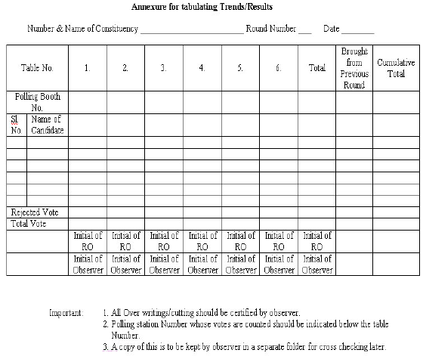
Counting of votes recorded in EVMs
Round wise statement proforma

Slide 23
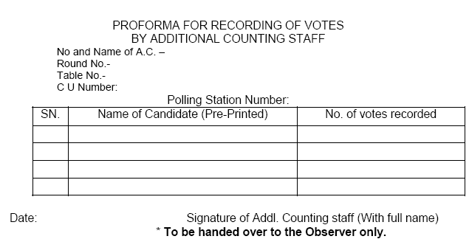
Sub Learning Objective 5: To carry out counting of votes recorded in EVMs as per ECI instructions
Proforma for recording of Votes by Additional Counting Staff

Slide 24
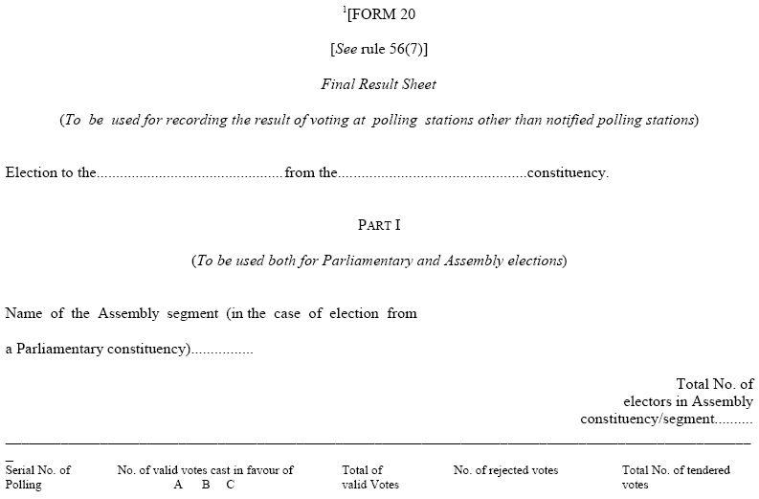
Sub Learning Objective 5: To carry out counting of votes recorded in EVMs as per ECI instructions
Annexure XLII of RO HB - Sample Final Result Sheet duly completed

Slide 25
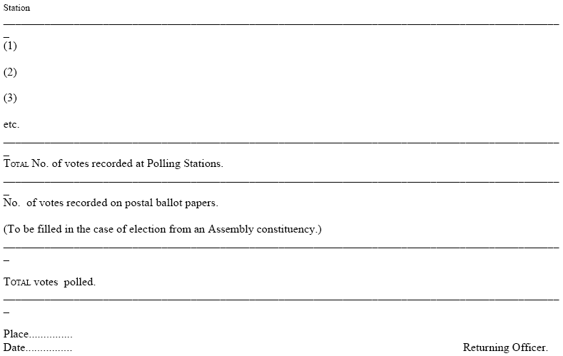
Sub Learning Objective 5: To carry out counting of votes recorded in EVMs as per ECI instructions

Slide 26
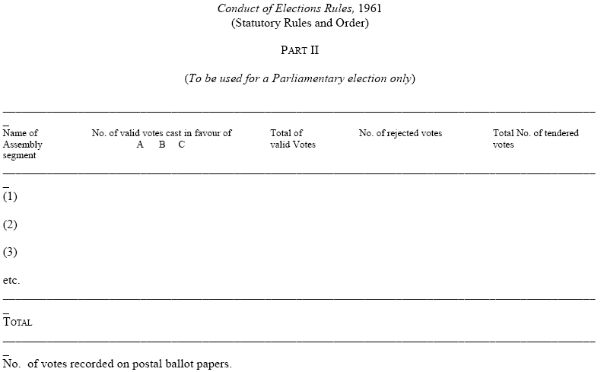
Sub Learning Objective 5: To carry out counting of votes recorded in EVMs as per ECI instructions

Slide 27
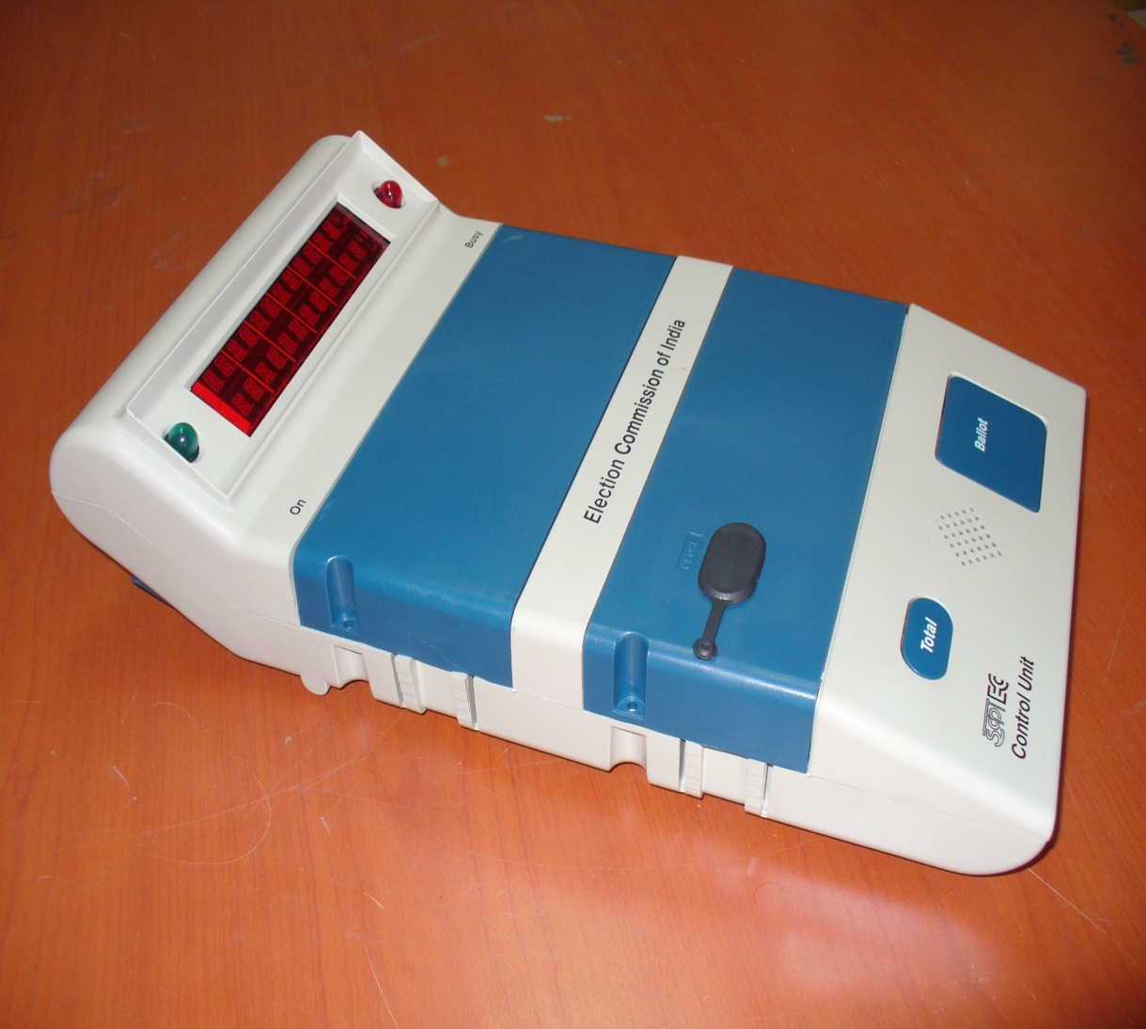
Components of Control Unit
Busy Lamp (Red)
Display Section
Candidate Set Section
Result Section
Ballot Section
Power ON Lamp (Green)

Slide 28
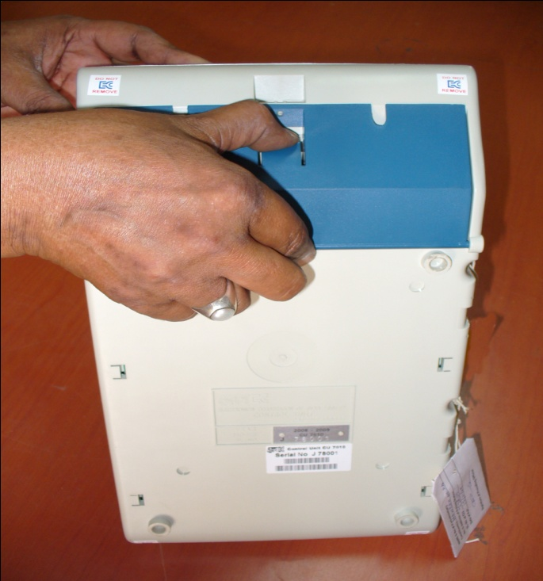
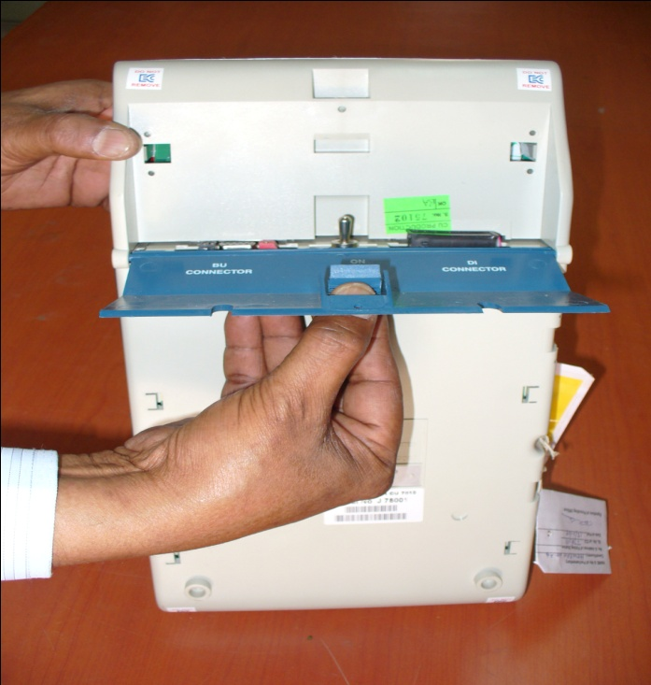
Components of Control Unit – How to open
Press Latch to release
Bottom Compartment Cover
Pull to open cover

Slide 29
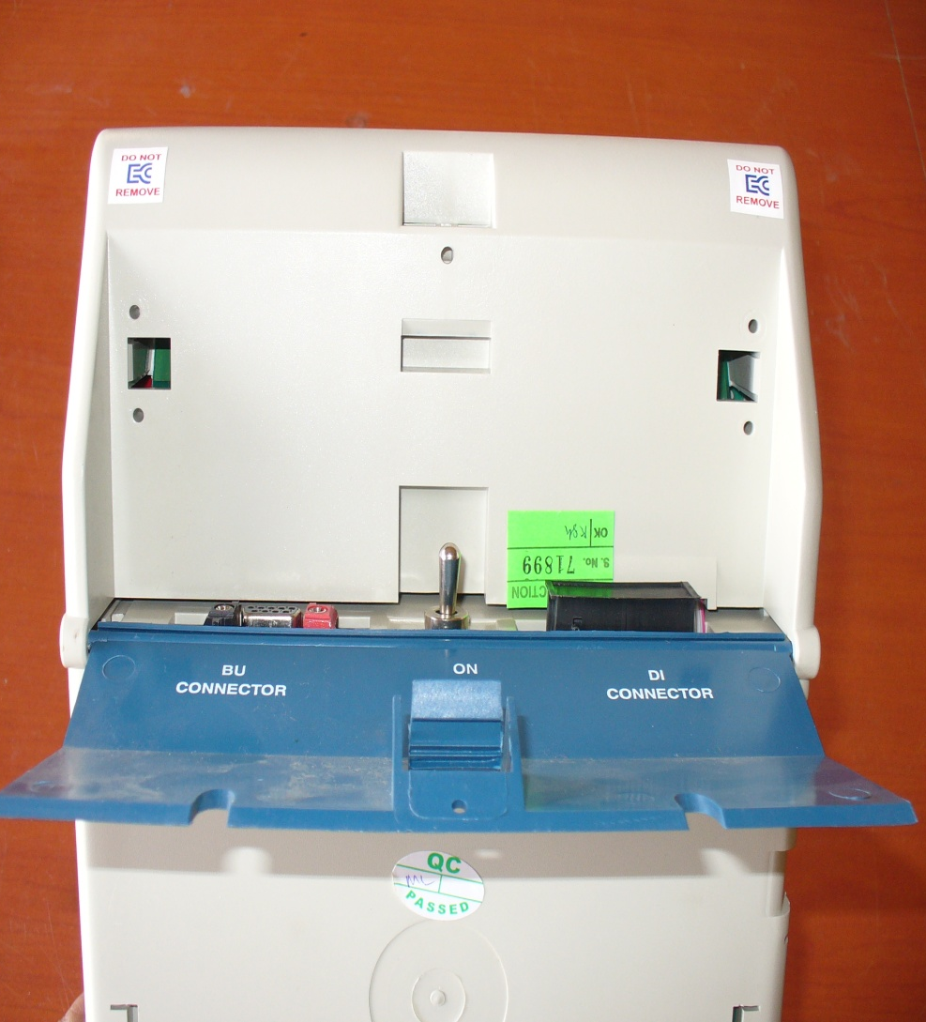
Components of Control Unit – Backside
Power Switch
Socket for connecting Data Interface.
Socket for Interconnecting Cable
of Balloting Unit

Slide 30
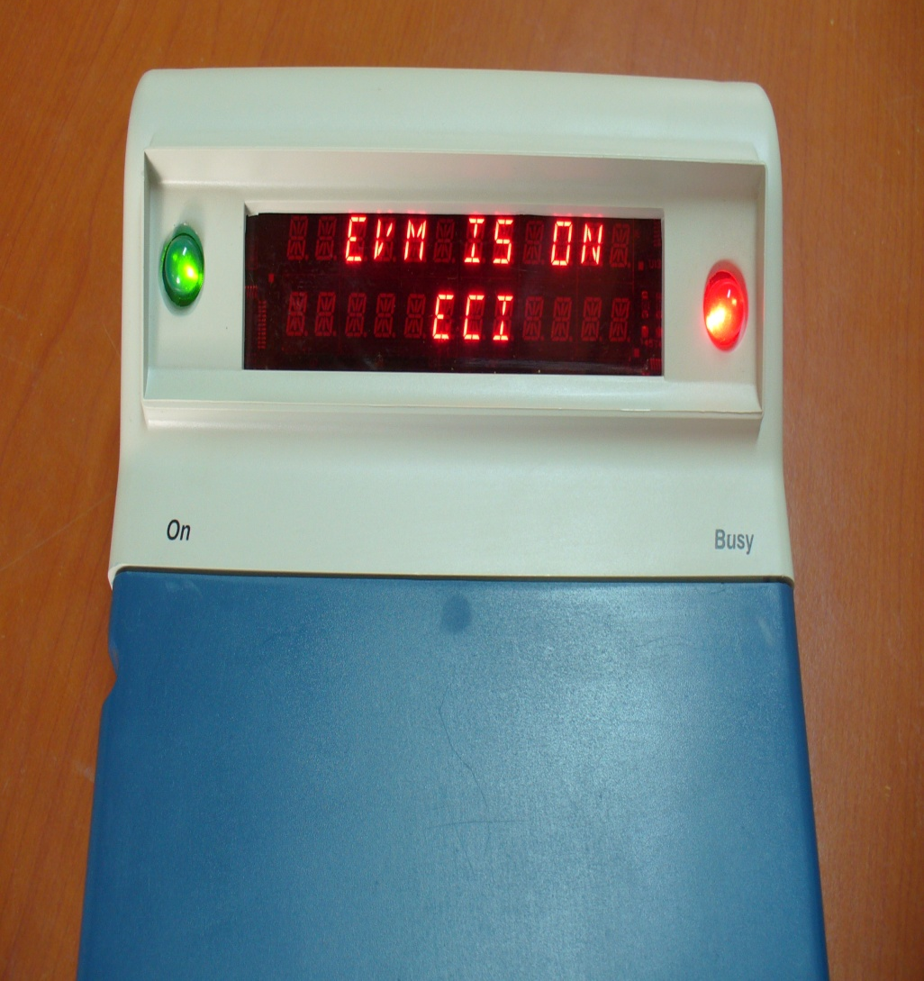
Components Control Unit – Display Section
Busy lamp glows ‘RED” when the ‘Ballot’ button is pressed by polling officer to enable the voter to cast vote. It goes off when the voter has cast his vote.
When no button is operated for 10-15 minutes, the CU goes to power save mode. Indicated by flickering of green ‘ON’ lamp in every 5 seconds.
Busy Lamp (Red)
Dual Line Digital Display Panel
Power ON Lamp (Green)

Slide 31
Meaning of various types of display
BATTERY LOW
Indicates that the capacity of the Battery is Low|
SL NO – E00001
Indicates the internal Serial number of the PCB
COMPUTING RESULT
Indicates that the RESULTS is getting computed
RESULT PDT 16-01-06
Indicates the Result and Date of the Poll
PST 09-50-20 PET 15-32-10
Indicates the Poll Starting Time and Poll End Time
CANDIDATE 06 236
Indicates that the Candidate No.6 has polled 236 votes

Slide 32
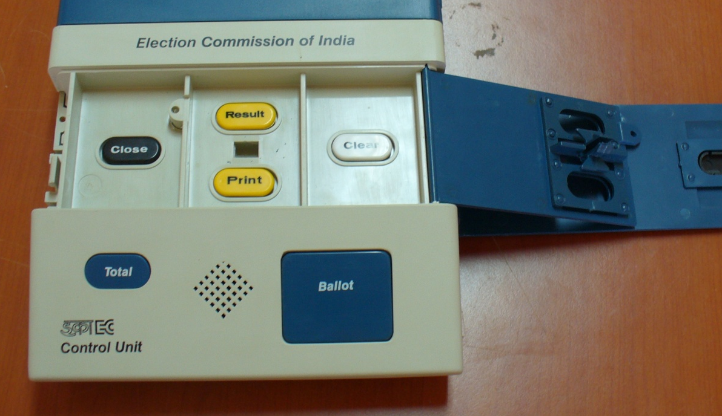
Components of Control Unit - Result Section
Close Button
Result Section
Outer Door
Result Button
Clear Button
Frame for Paper Seals
Holes to pass thread for sealing
Inner Compartment Door
Print Button
Inner Latches
Outer Door

Slide 33
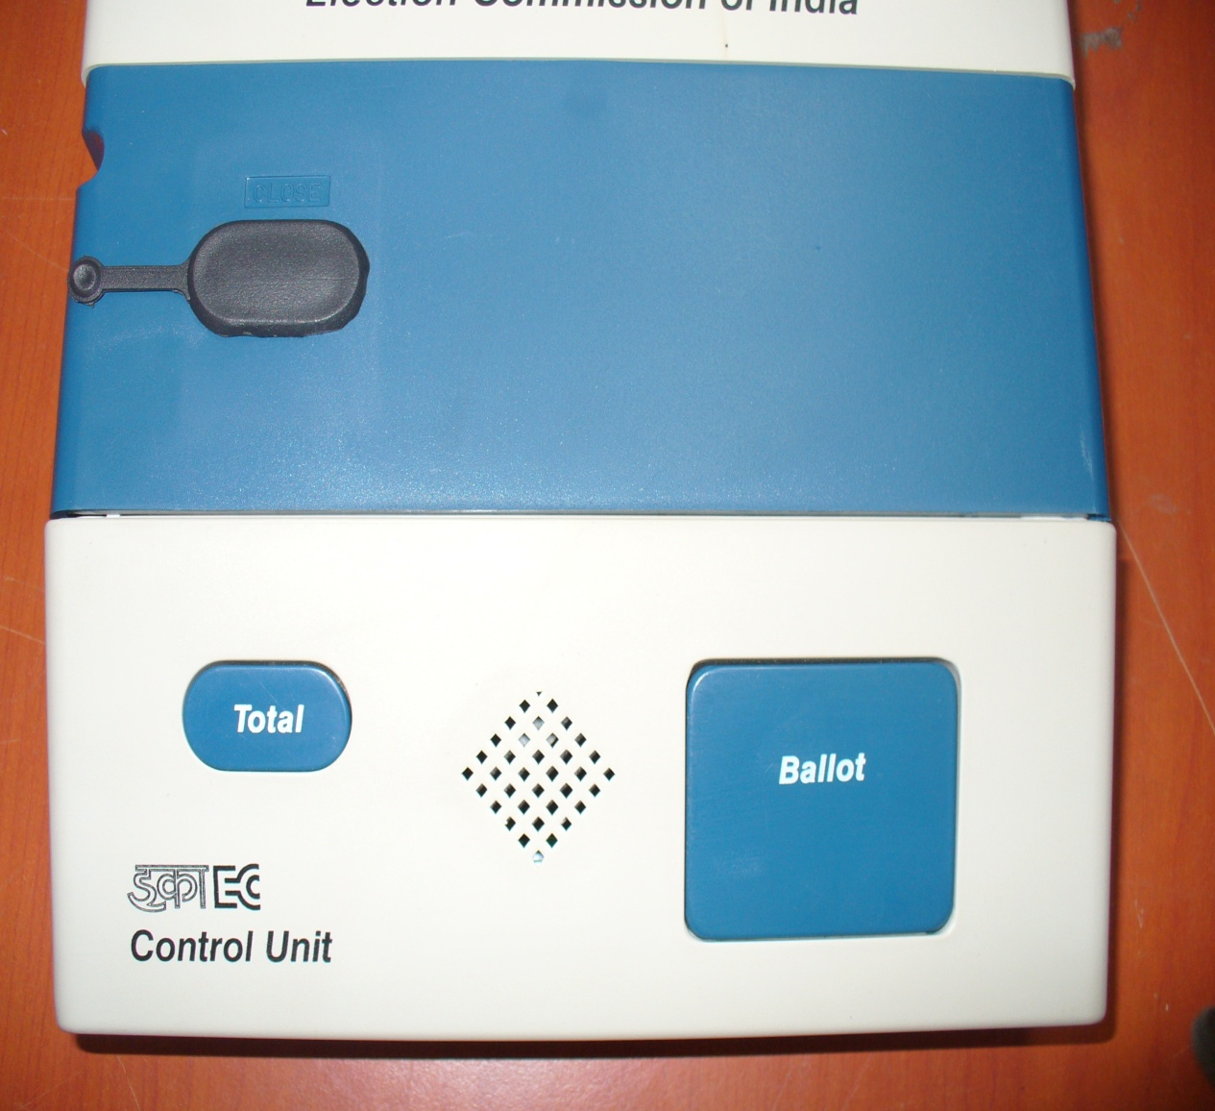
Components of Control Unit
Total Button
Buzzer
Ballot Button

